Slide 1







Cover
Prob
$$P_{Loss}$$
$$P_{Subs}$$
$$Q_{DER}$$
Large Distribution Model Simulations
$$P_{12}$$
$$Q_{12}$$
Aryan Ritwajeet Jha
$$V_{1}$$
Observation of the effect of change in parameter values on Distributed OPF Simulations for the synthetic 1k* Power Distribution networks.
$$ΔV$$
*10k system to be added later.

Slide 2
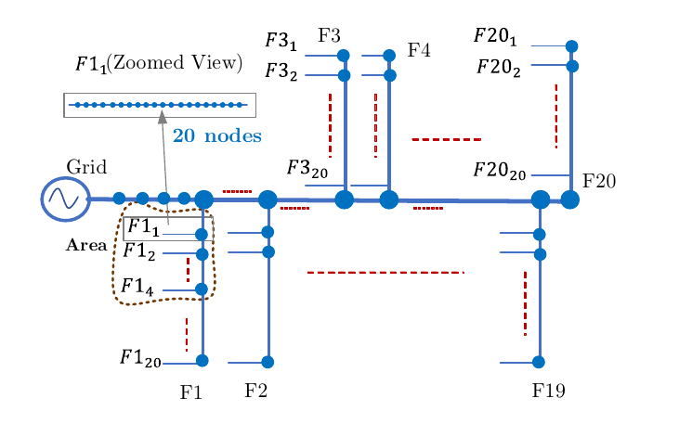
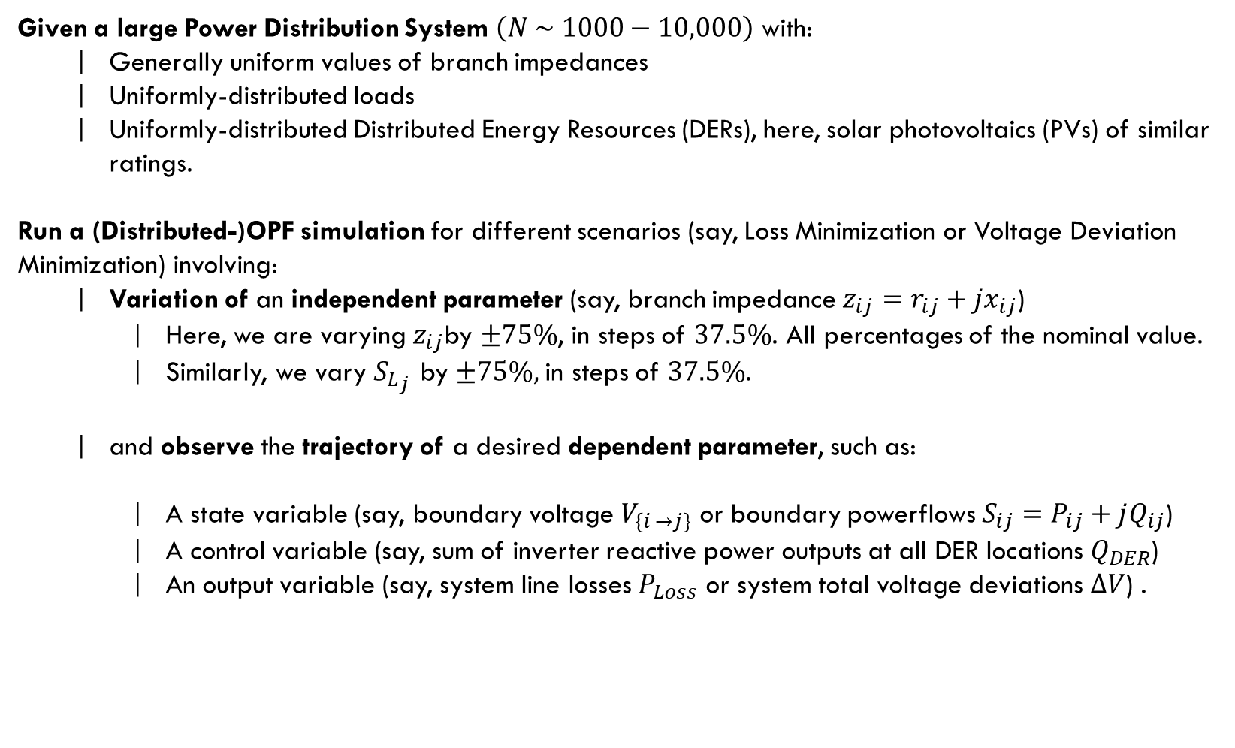
Cover
Prob
C
Problem Statement
Prob
B
$$P_{Loss}$$
A
$$P_{Subs}$$
Given a large Power Distribution System $\left(N \sim 1000−10,000\right)$ with:
Generally uniform values of branch impedances
Uniformly-distributed loads
Uniformly-distributed Distributed Energy Resources (DERs), here, solar photovoltaics (PVs) of similar ratings.
Run a (Distributed-)OPF simulation for different scenarios (say, Loss Minimization or Voltage Deviation Minimization) involving:
Variation of an independent parameter (say, branch impedance $z_{ij}=r_{ij}+{jx}_{ij}$)
Here, we are varying $z_{ij}$by $±75\%$, in steps of $37.5\%$. All percentages of the nominal value.
Similarly, we vary ${S_{L}}_{j}$ by $±75\%,$in steps of $37.5\%$.
and observe the trajectory of a desired dependent parameter, such as:
A state variable (say, boundary voltage $V_{\left\{i →j\right\}}$ or boundary powerflows $S_{ij}=P_{ij}+jQ_{ij}$)
A control variable (say, sum of inverter reactive power outputs at all DER locations $Q_{DER}$)
An output variable (say, system line losses $P_{Loss}$ or system total voltage deviations $ΔV$) .
Synthetic 10k Distribution Network
$$Q_{DER}$$
$$P_{12}$$
$$Q_{12}$$
$$V_{1}$$
$$ΔV$$

Slide 3
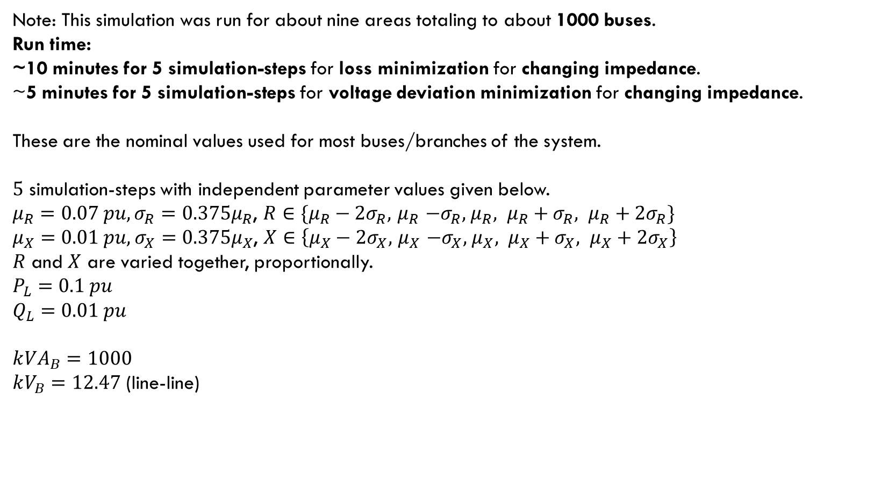
Cover
Prob
Simulation Type 1:
Varying Line Impedances
Fixed Demand Loads
C
Prob
B
$$P_{Loss}$$
A
$$P_{Subs}$$
Note: This simulation was run for about nine areas totaling to about 1000 buses.
Run time:
~10 minutes for 5 simulation-steps for loss minimization for changing impedance.
~5 minutes for 5 simulation-steps for voltage deviation minimization for changing impedance.
These are the nominal values used for most buses/branches of the system.
$5$ simulation-steps with independent parameter values given below.
$μ_{R}=0.07 pu, σ_{R}=0.375μ_{R}$, $R∈\{μ_{R}−2σ_{R}, { μ}_{R} −σ_{R}, { μ}_{R}, μ_{R}+σ_{R}, μ_{R}+2σ_{R}\}$
$μ_{X}=0.01 pu, σ_{X}=0.375μ_{X}$, $X∈\left\{μ_{X}−2σ_{X}, { μ}_{X} −σ_{X}, { μ}_{X}, μ_{X}+σ_{X}, μ_{X}+2σ_{X}\right\}$
$R$ and $X$ are varied together, proportionally. $$P_{L}=0.1 pu$$
$Q_{L}=0.01 pu$
$$k{VA}_{B}=1000$$ $kV_{B}=12.47$ (line-line)
Synthetic 10k Distribution Network
$$Q_{DER}$$
$$P_{12}$$
$$Q_{12}$$
$$V_{1}$$
$$ΔV$$

Slide 4
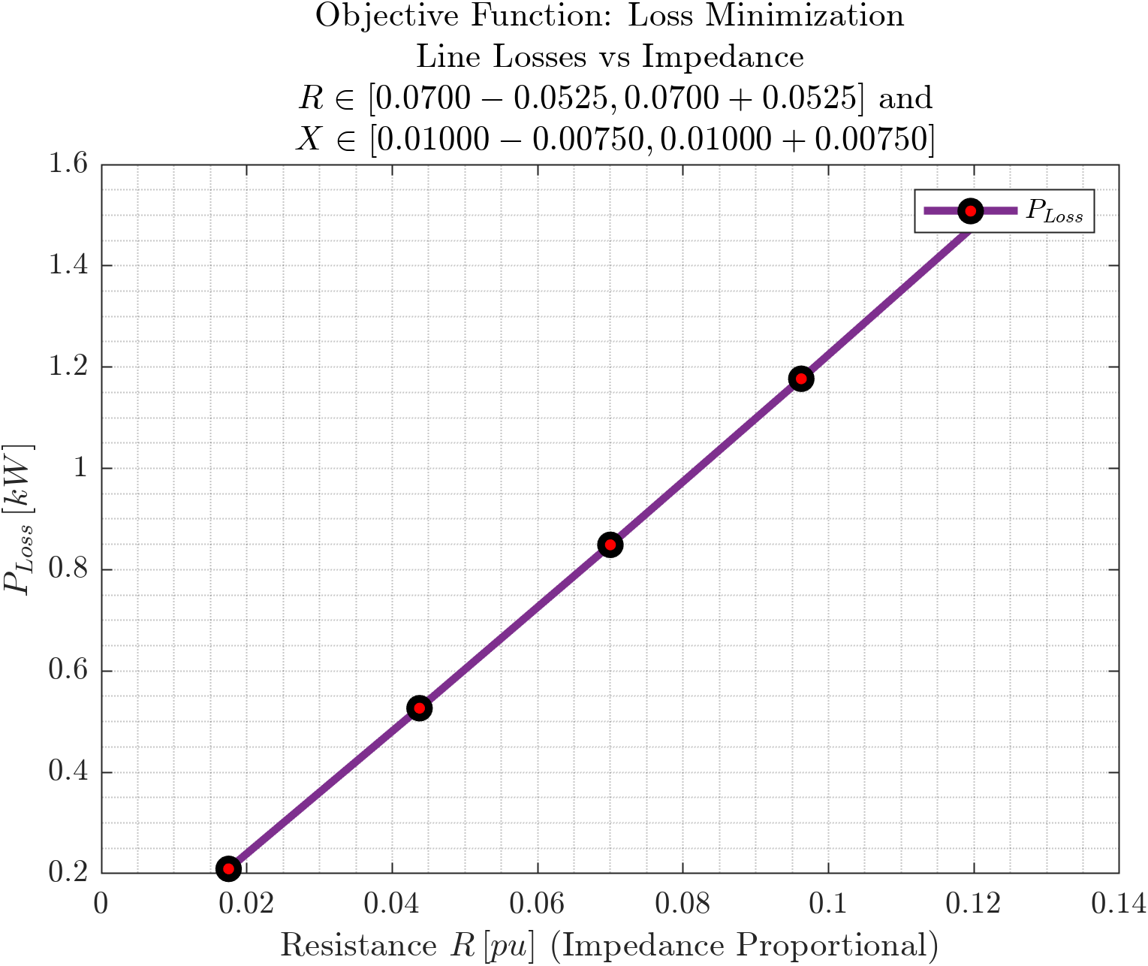
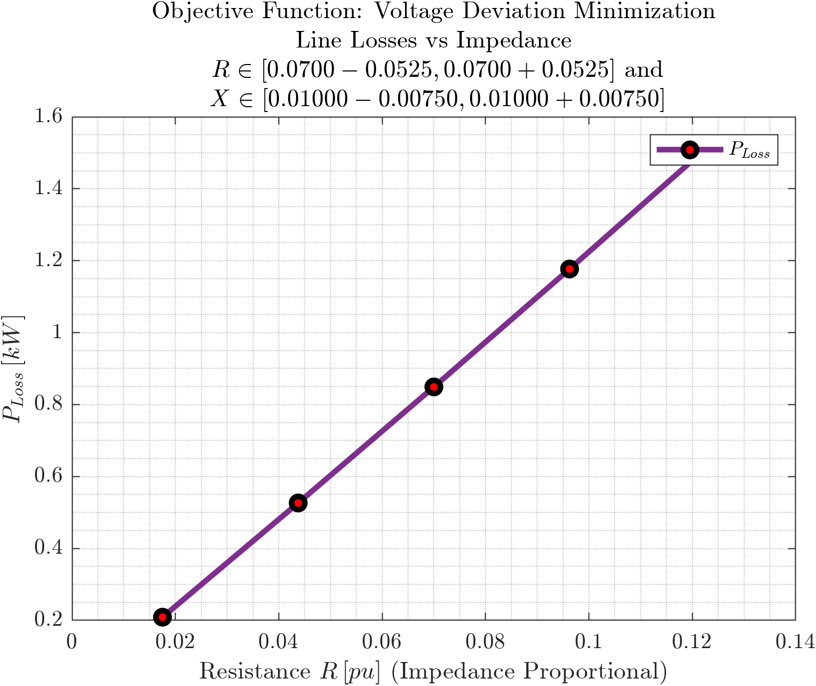
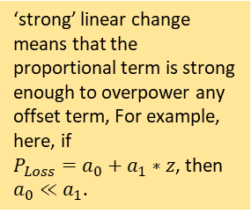
D
Cover
Line Losses vs Branch Impedance
C
Prob
Objective Functions: Loss Minimization, Voltage Deviation Minimization
B
$$P_{Loss}$$
A
$$P_{Subs}$$
$$Q_{DER}$$
$$P_{12}$$
$$Q_{12}$$
$$V_{1}$$
‘strong’ linear change means that the proportional term is strong enough to overpower any offset term, For example, here, if $P_{Loss}=a_{0}+a_{1}∗z$, then $a_{0}≪a_{1}$.
$$ΔV$$
Linear change in branch impedance $z$ caused a strong Linear change in line losses $P_{Loss}$

Slide 5
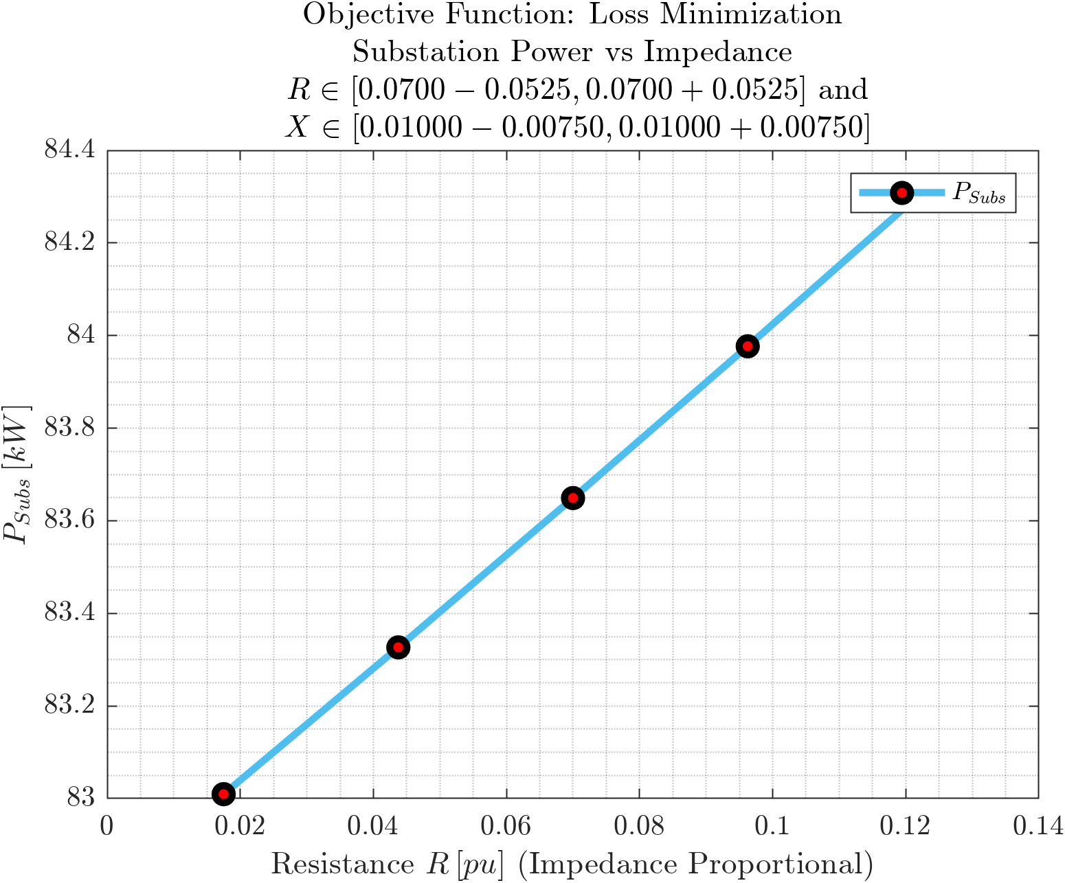
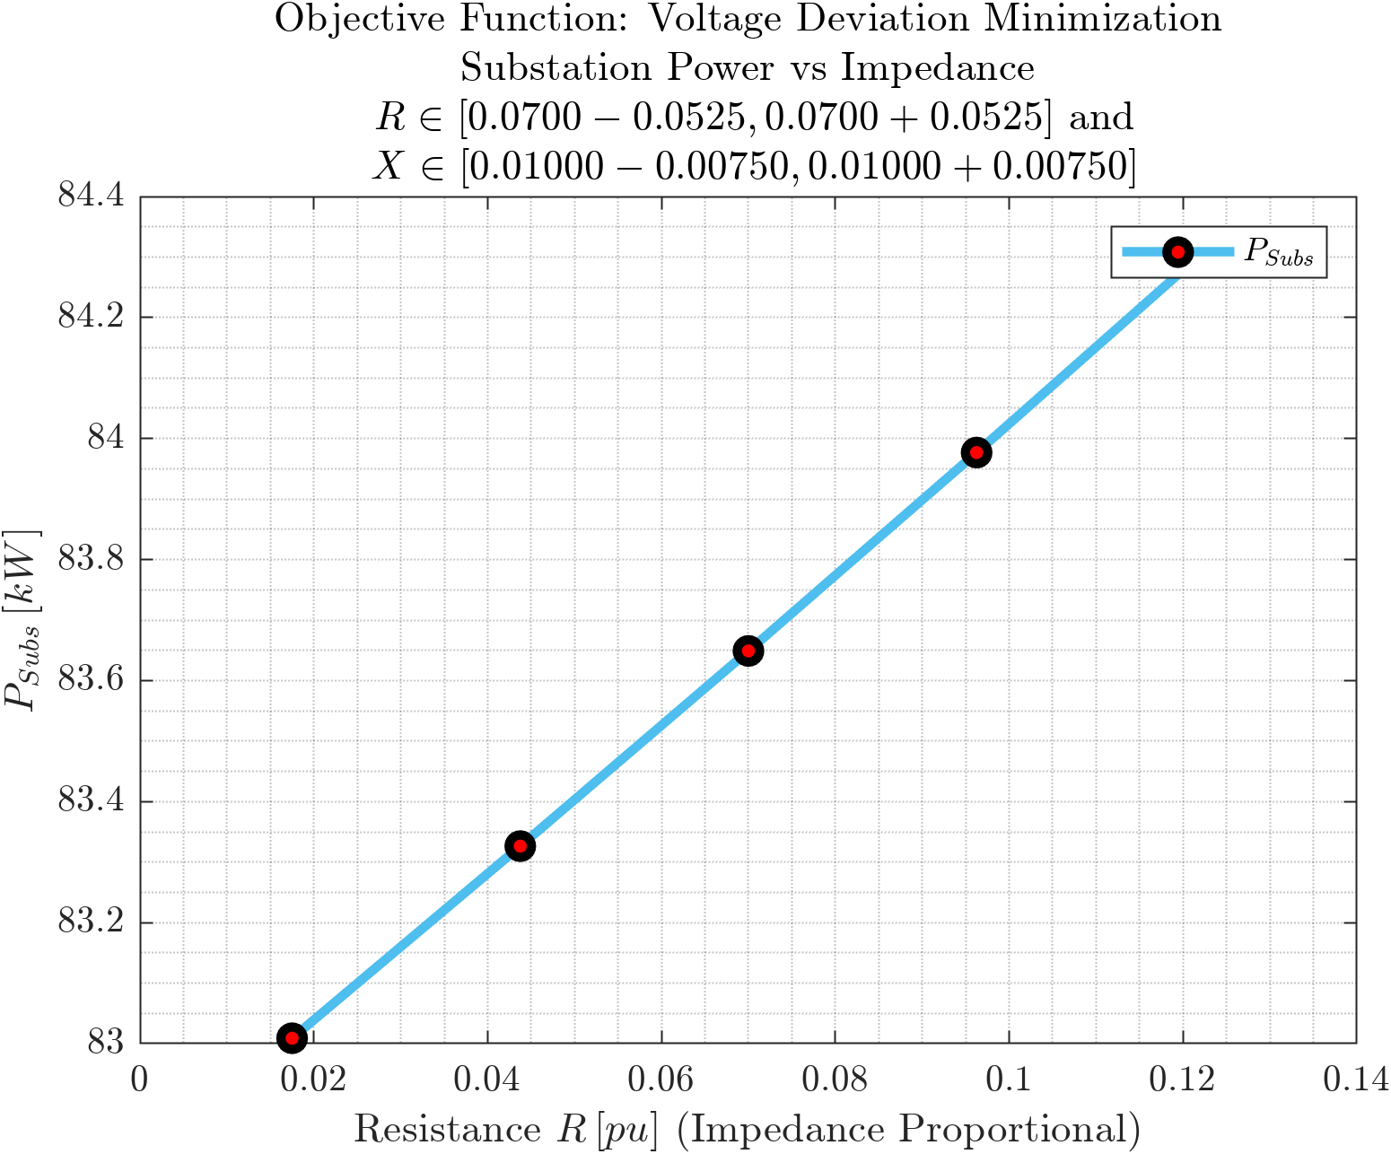
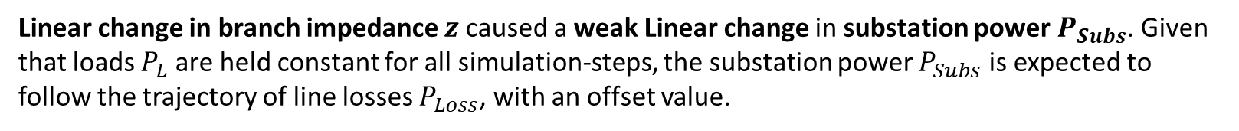
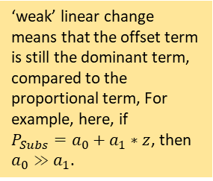
D
Cover
Substation Power vs Branch Impedance
C
Prob
Objective Functions: Loss Minimization, Voltage Deviation Minimization
B
$$P_{Loss}$$
A
$$P_{Subs}$$
$$Q_{DER}$$
$$P_{12}$$
$$Q_{12}$$
‘weak’ linear change means that the offset term is still the dominant term, compared to the proportional term, For example, here, if $P_{Subs}=a_{0}+a_{1}∗z$, then $a_{0}≫a_{1}$.
$$V_{1}$$
$$ΔV$$
Linear change in branch impedance $z$ caused a weak Linear change in substation power $P_{Subs}$. Given that loads $P_{L}$ are held constant for all simulation-steps, the substation power $P_{Subs}$ is expected to follow the trajectory of line losses $P_{Loss}$, with an offset value.

Slide 6
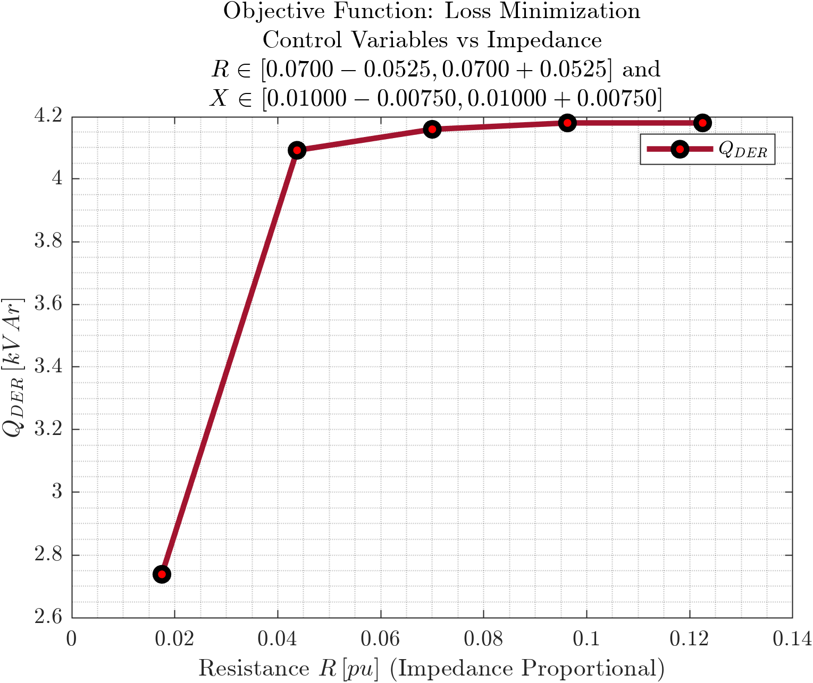
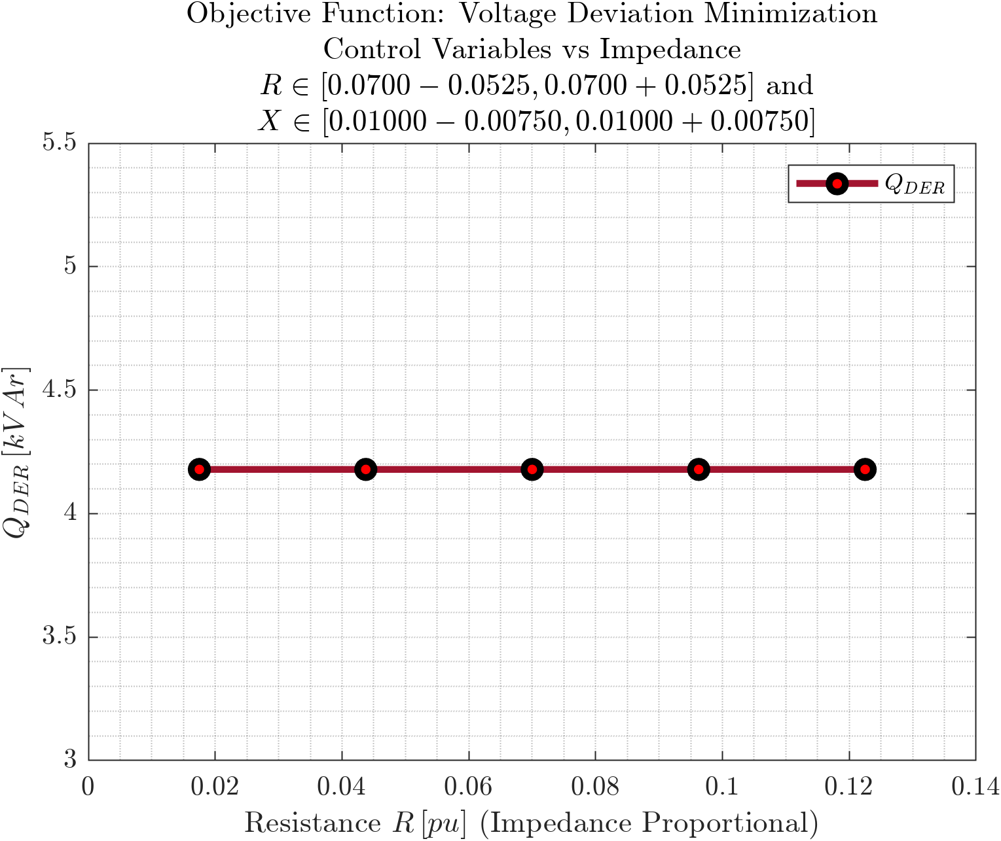
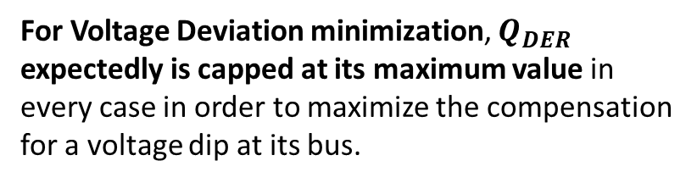
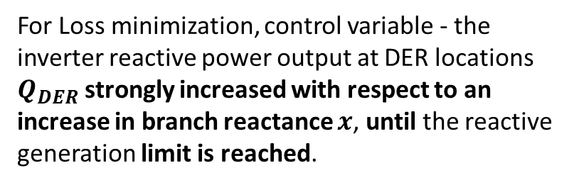
D
Cover
DER Reactive Power vs Branch Impedance
C
Prob
Objective Functions: Loss Minimization, Voltage Deviation Minimization
B
$$P_{Loss}$$
A
$$P_{Subs}$$
$$Q_{DER}$$
$$P_{12}$$
$$Q_{12}$$
$$V_{1}$$
$$ΔV$$
For Loss minimization, control variable - the inverter reactive power output at DER locations $Q_{DER}$ strongly increased with respect to an increase in branch reactance $x$, until the reactive generation limit is reached.
For Voltage Deviation minimization, $Q_{DER}$ expectedly is capped at its maximum value in every case in order to maximize the compensation for a voltage dip at its bus.

Slide 7
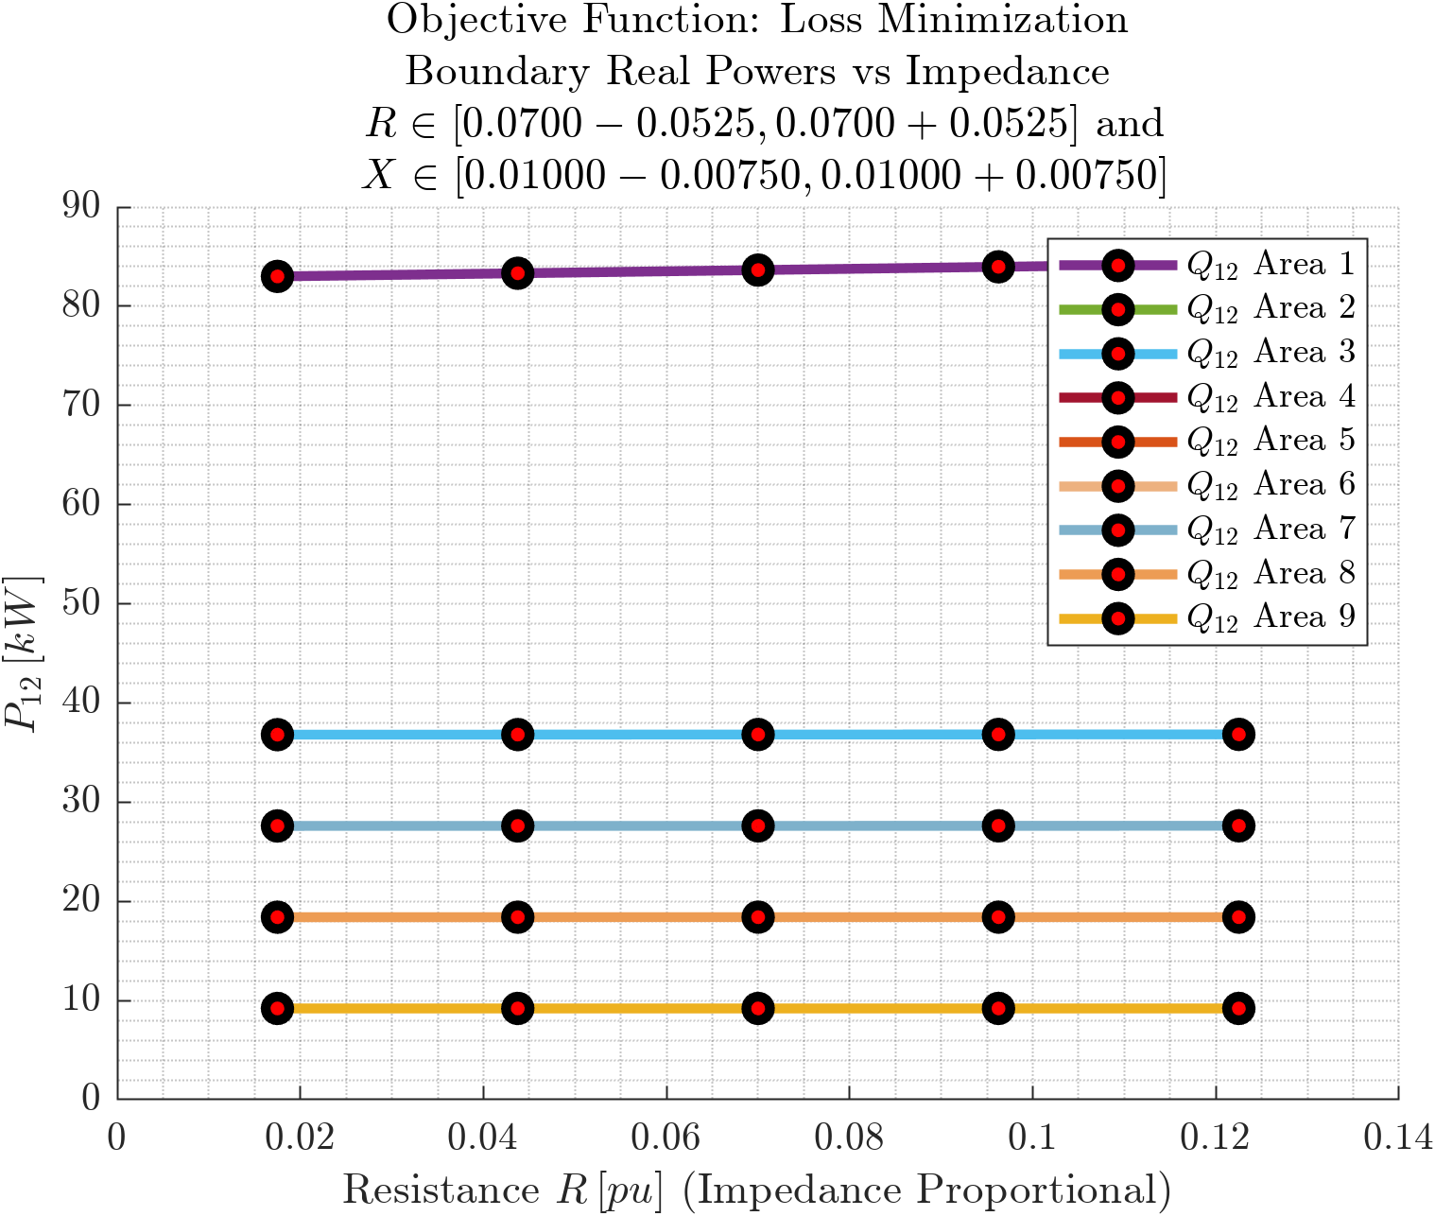
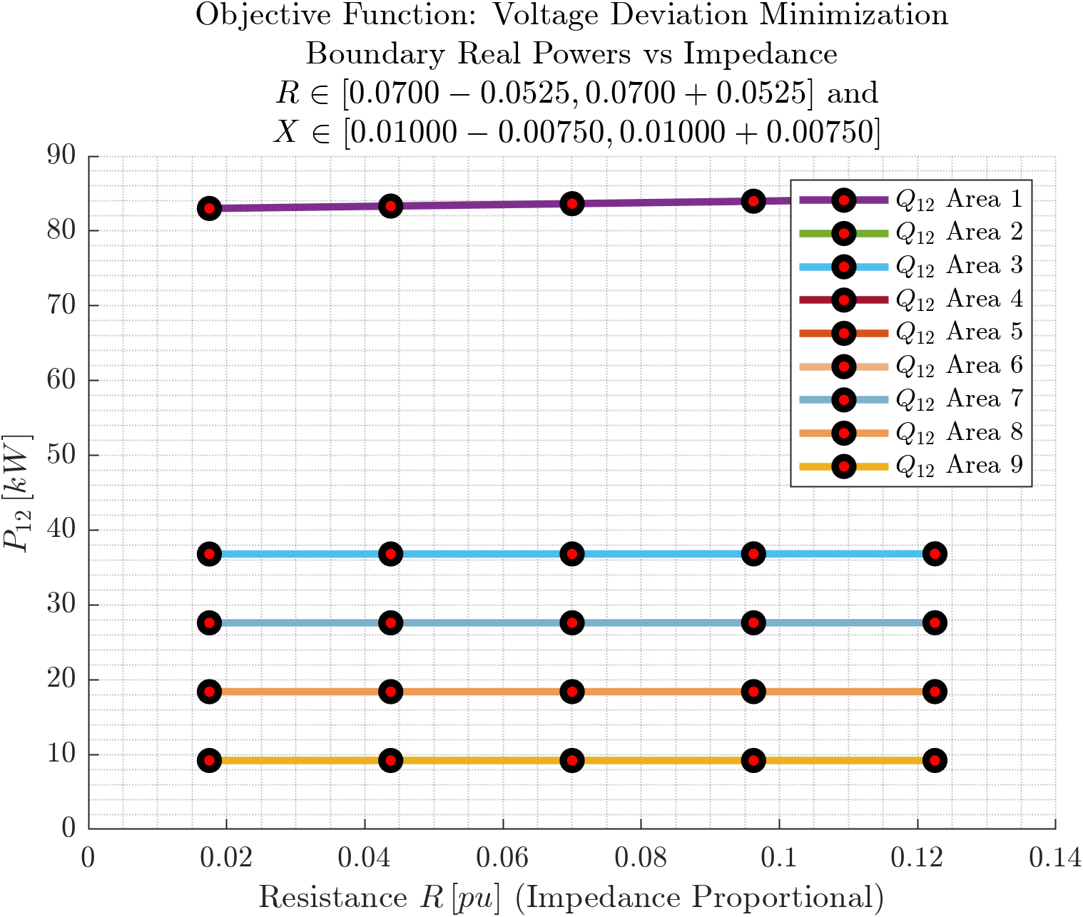
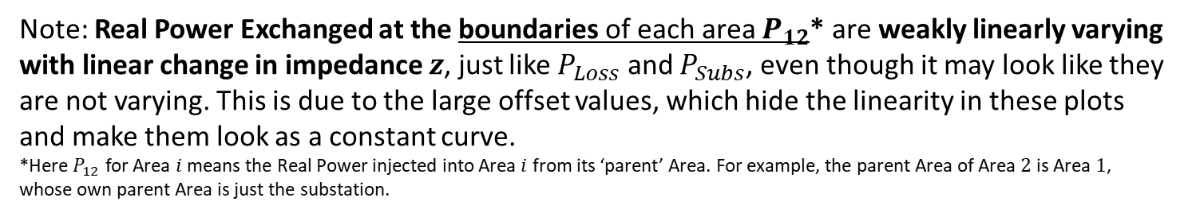

Cover
Real Power at Area Boundaries vs Branch Impedance
Prob
C
Prob
Objective Functions: Loss Minimization, Voltage Deviation Minimization
Error in legend entries, they mean $P_{12}$
B
$$P_{Loss}$$
A
$$P_{Subs}$$
$$Q_{DER}$$
$$P_{12}$$
$$Q_{12}$$
$$V_{1}$$
$$ΔV$$
Note: Real Power Exchanged at the boundaries of each area $P_{12}$* are weakly linearly varying with linear change in impedance $z$, just like $P_{Loss}$ and $P_{Subs}$, even though it may look like they are not varying. This is due to the large offset values, which hide the linearity in these plots and make them look as a constant curve. *Here $P_{12}$ for Area $i$ means the Real Power injected into Area $i$ from its ‘parent’ Area. For example, the parent Area of Area $2$ is Area $1$, whose own parent Area is just the substation.

Slide 8
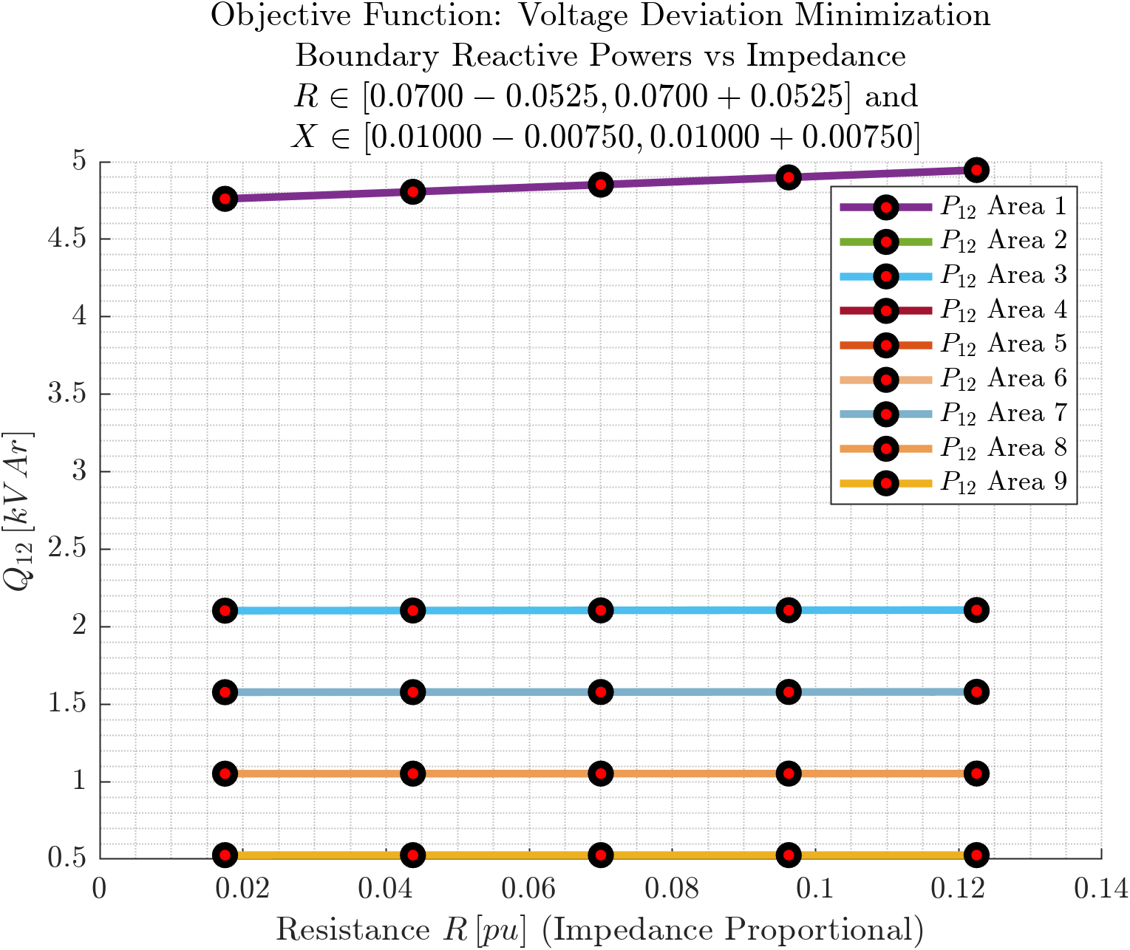
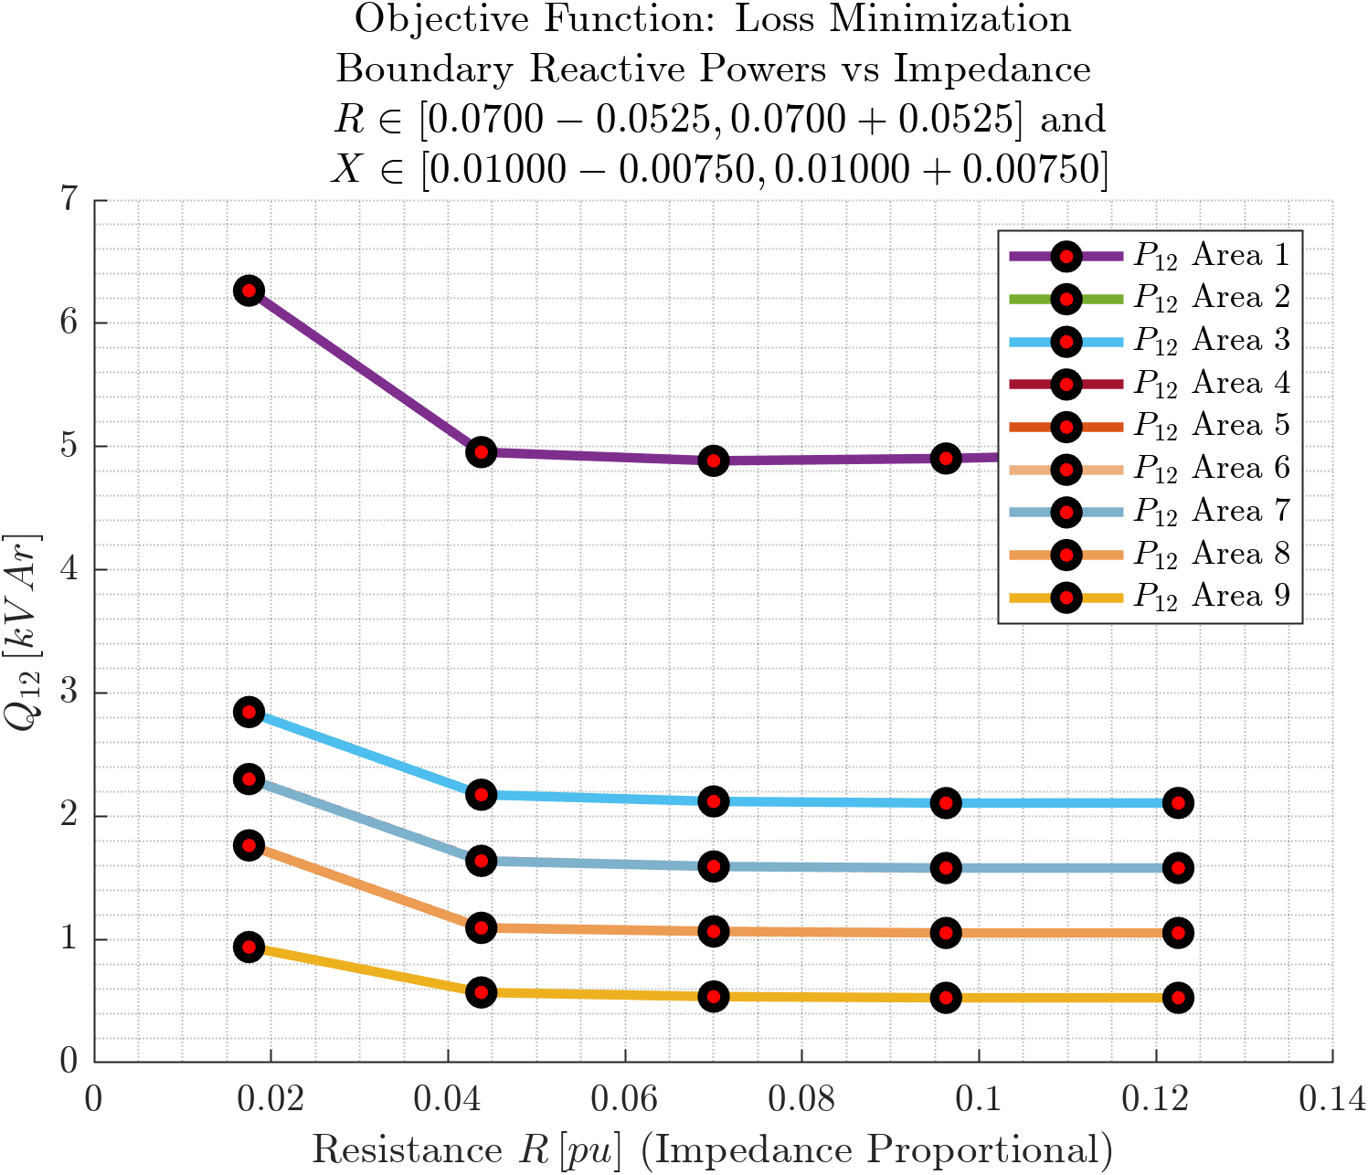
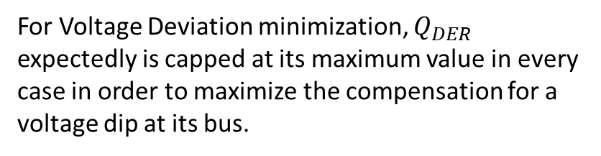
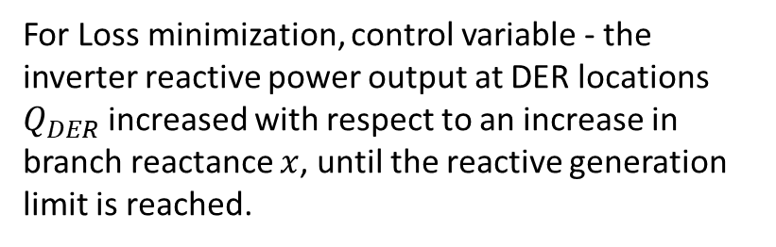
D
Cover
Reactive Power at Area Boundaries vs Branch Impedance
C
Prob
Objective Functions: Loss Minimization, Voltage Deviation Minimization
B
$$P_{Loss}$$
A
$$P_{Subs}$$
$$Q_{DER}$$
$$P_{12}$$
$$Q_{12}$$
$$V_{1}$$
$$ΔV$$
For Loss minimization, control variable - the inverter reactive power output at DER locations $Q_{DER}$ increased with respect to an increase in branch reactance $x$, until the reactive generation limit is reached.
For Voltage Deviation minimization, $Q_{DER}$ expectedly is capped at its maximum value in every case in order to maximize the compensation for a voltage dip at its bus.

Slide 9
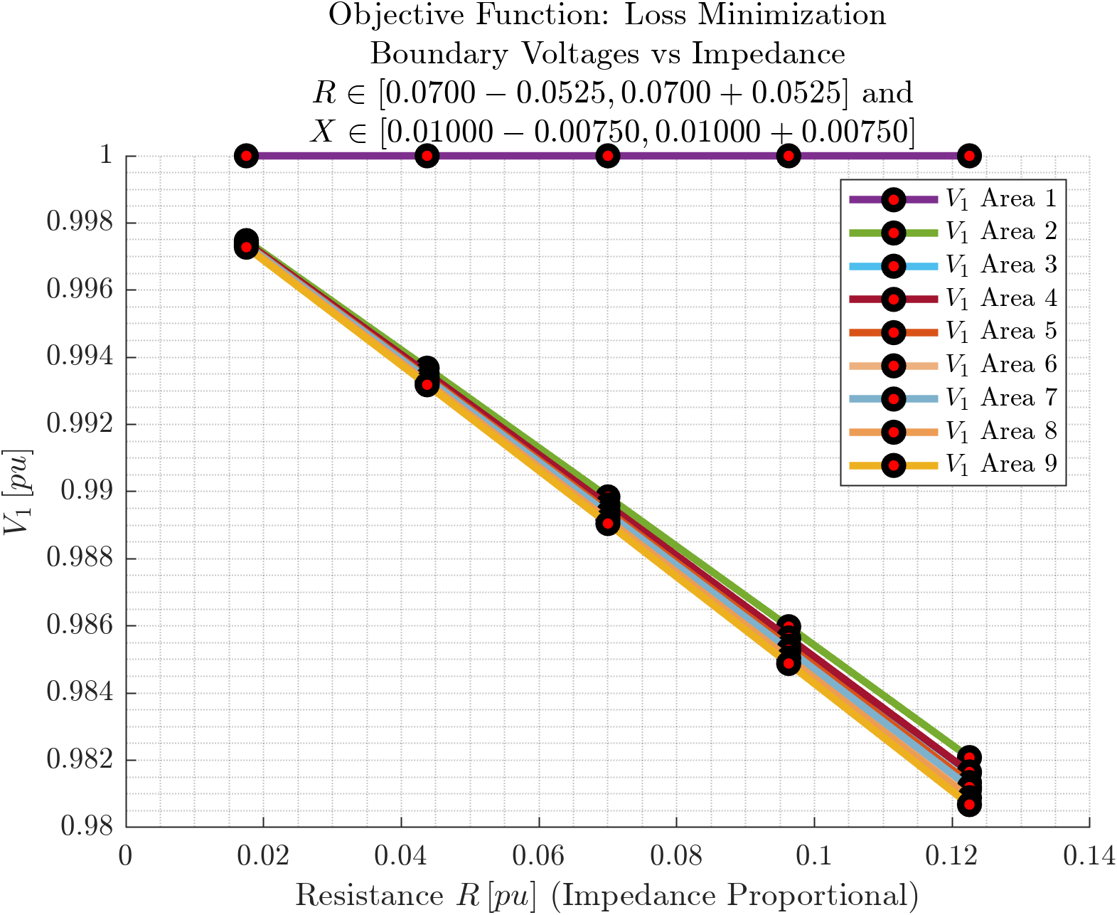
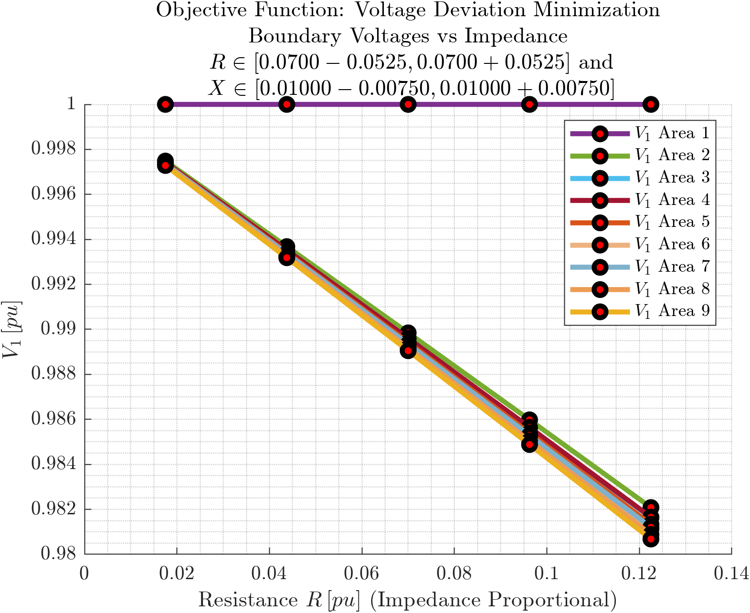
D
Cover
Voltages at Area Boundaries vs Branch Impedance
C
Prob
Objective Functions: Loss Minimization, Voltage Deviation Minimization
B
$$P_{Loss}$$
A
$$P_{Subs}$$
$$Q_{DER}$$
$$P_{12}$$
$$Q_{12}$$
$$V_{1}$$
$$ΔV$$
Boundary Voltage drop $ΔV$ is weakly linearly increasing ($V_{1}$ is linearly decreasing) with impedance $z$. The trend, including the range of variation is same as that for varying loading.

Slide 10
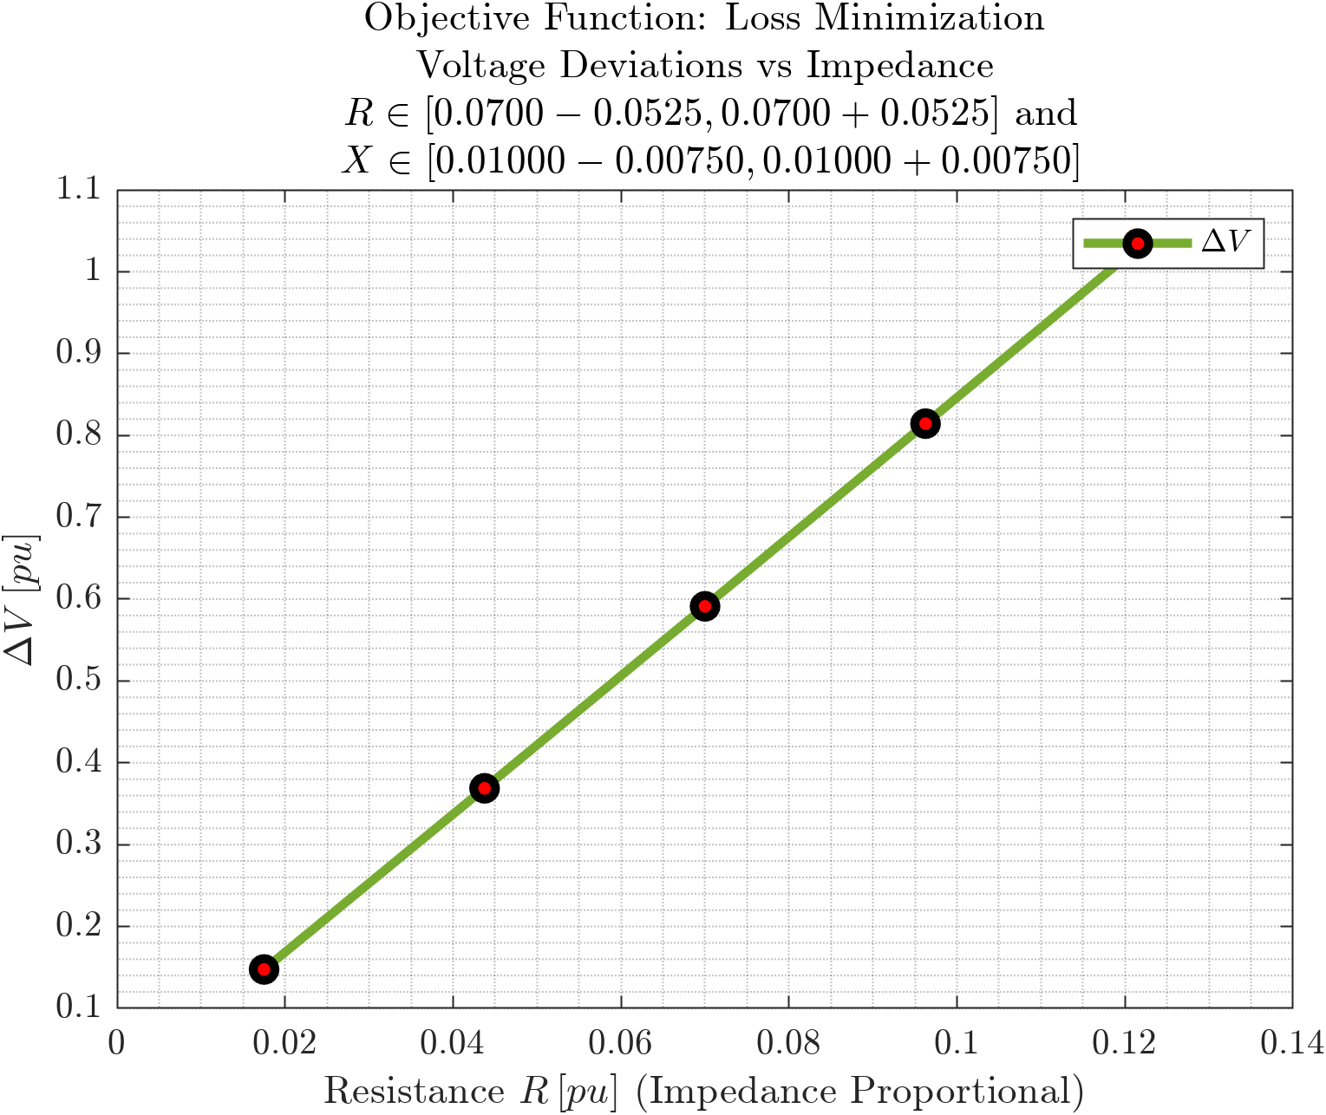
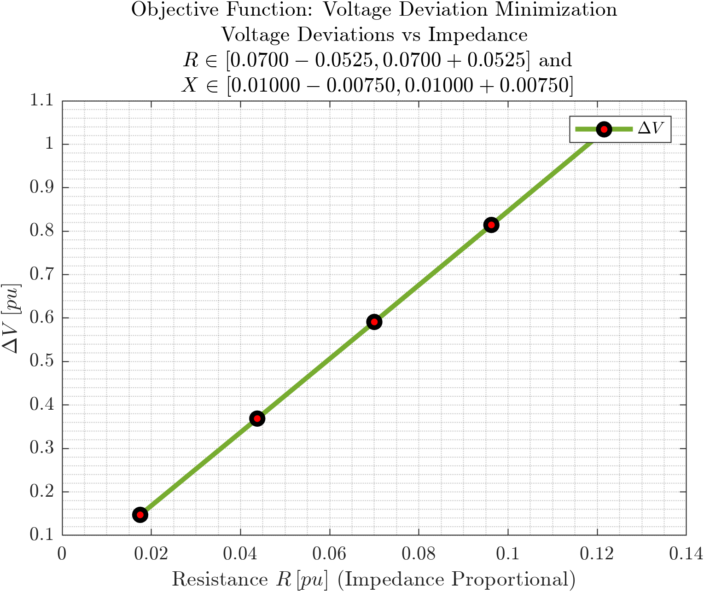
D
Cover
Voltage Deviation vs Branch Impedance
C
Prob
Objective Functions: Loss Minimization, Voltage Deviation Minimization
B
$$P_{Loss}$$
A
$$P_{Subs}$$
$$Q_{DER}$$
$$P_{12}$$
$$Q_{12}$$
$$V_{1}$$
$$ΔV$$
Boundary Voltage $V_{1}$is weakly linearly decreasing (voltage drop $ΔV$ is strongly linearly increasing) with impedance $z$. The trend is almost the same as that for varying loading.

Slide 11


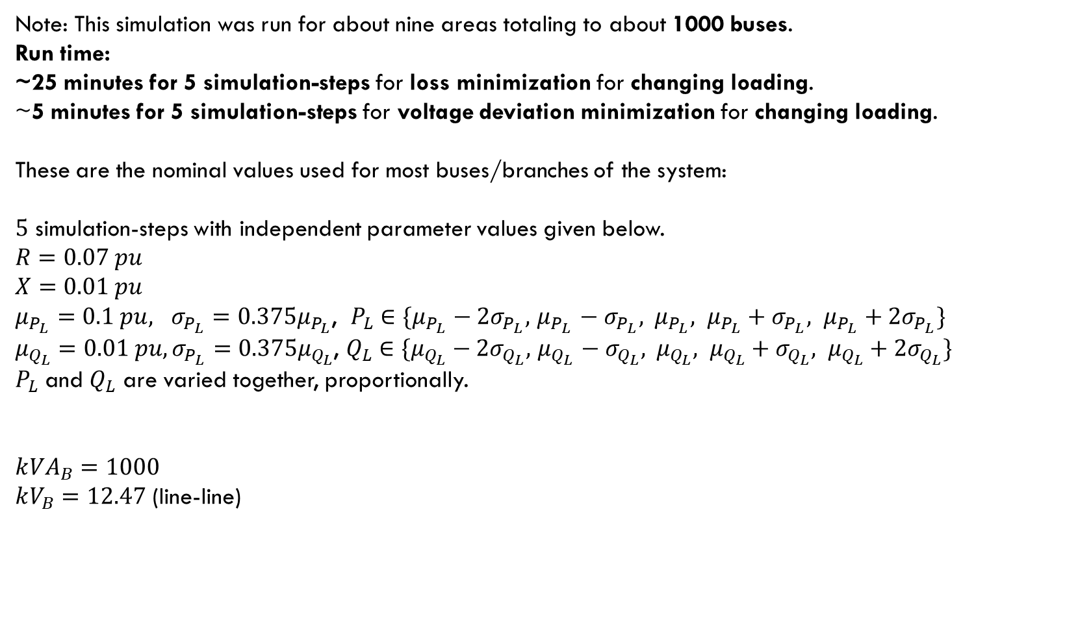





Simulation Type 2:
Varying Load Demands
Fixed Impedances
Synthetic 10k Distribution Network
Note: This simulation was run for about nine areas totaling to about 1000 buses.
Run time:
~25 minutes for 5 simulation-steps for loss minimization for changing loading.
~5 minutes for 5 simulation-steps for voltage deviation minimization for changing loading.
These are the nominal values used for most buses/branches of the system:
$5$ simulation-steps with independent parameter values given below.
$$R=0.07 pu$$
$$X=0.01 pu$$ $μ_{P_{L}}=0.1 pu, σ_{P_{L}}=0.375μ_{P_{L}}$, $P_{L}∈\{μ_{P_{L}}−2σ_{P_{L}}, { μ}_{P_{L}} − σ_{P_{L}}, { μ}_{P_{L}}, μ_{P_{L}}+σ_{P_{L}}, μ_{P_{L}}+2σ_{P_{L}}\}$
$μ_{Q_{L}}=0.01 pu, σ_{P_{L}}=0.375μ_{Q_{L}}$, $Q_{L}∈\{μ_{Q_{L}}−2σ_{Q_{L}}, { μ}_{Q_{L}} −{ σ}_{Q_{L}}, { μ}_{Q_{L}}, μ_{Q_{L}}+σ_{Q_{L}}, μ_{Q_{L}}+2σ_{Q_{L}}\}$
$P_{L}$ and $Q_{L}$ are varied together, proportionally.
$$k{VA}_{B}=1000$$ $kV_{B}=12.47$ (line-line)
Cover
Prob
$$P_{Loss}$$
$$P_{Subs}$$
$$Q_{DER}$$
$$P_{12}$$
$$Q_{12}$$
$$V_{1}$$
$$ΔV$$

Slide 12
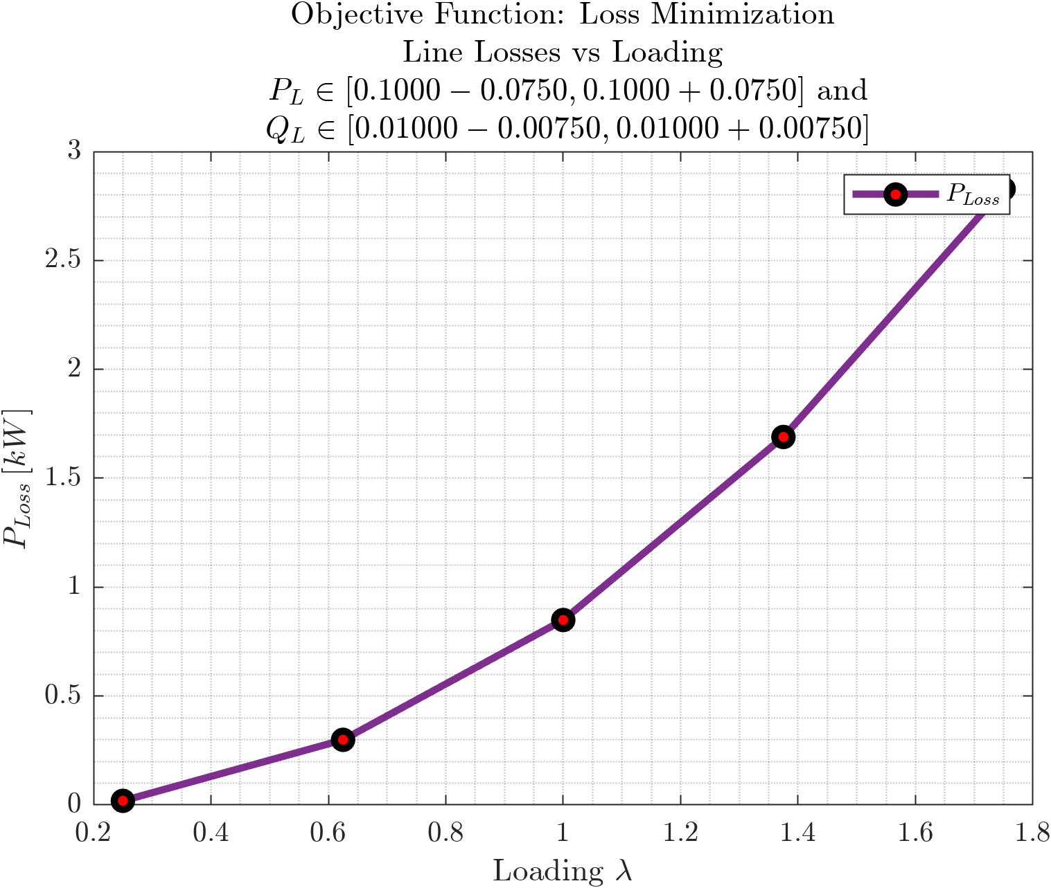
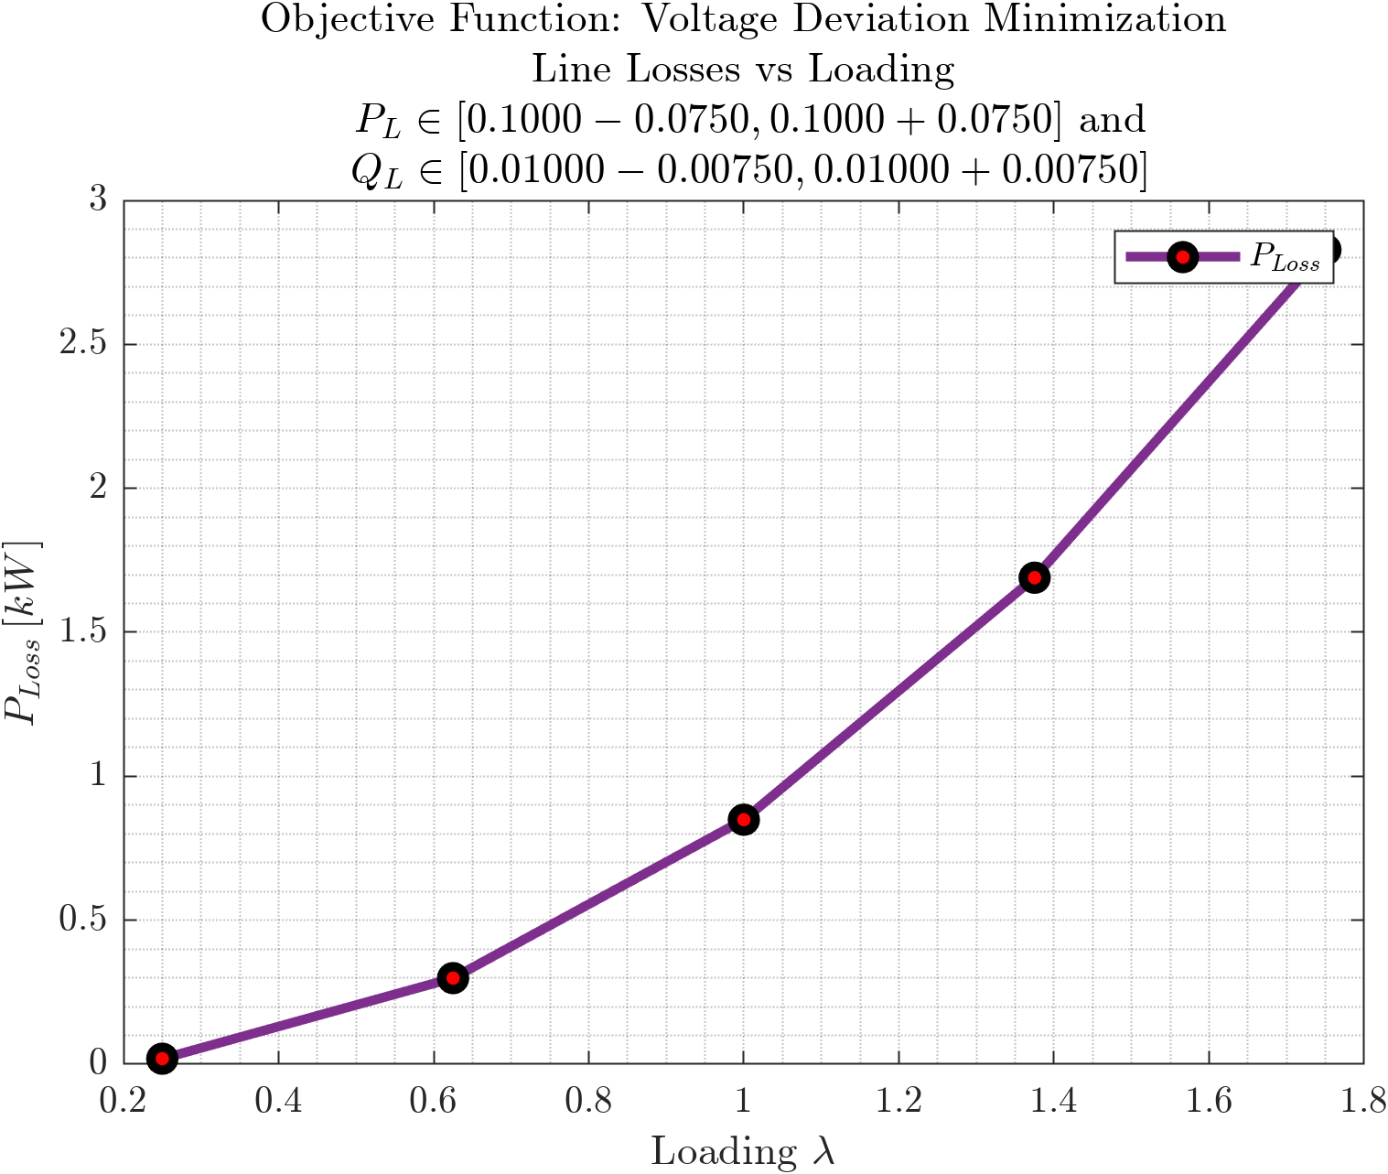
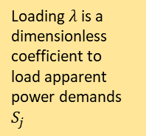
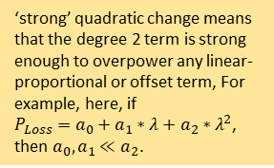
Line Losses vs Load Demand
Objective Functions: Loss Minimization, Voltage Deviation Minimization
Cover
Prob
$$P_{Loss}$$
$$P_{Subs}$$
$$Q_{DER}$$
‘strong’ quadratic change means that the degree 2 term is strong enough to overpower any linear-proportional or offset term, For example, here, if $P_{Loss}=a_{0}+a_{1}∗λ+a_{2}∗λ^{2}$, then $a_{0}, a_{1}≪a_{2}$.
$$P_{12}$$
Loading $λ$is a dimensionless coefficient to load apparent power demands $S_{j}$
$$Q_{12}$$
Linear change in loading $λ$ caused a strong Quadratic change in line losses $P_{Loss}$.
(MATLAB’s polyfit says it’s like $P_{Loss}=1.02λ^{2}−0.1708λ+0.001$)
$$V_{1}$$
$$ΔV$$

Slide 13
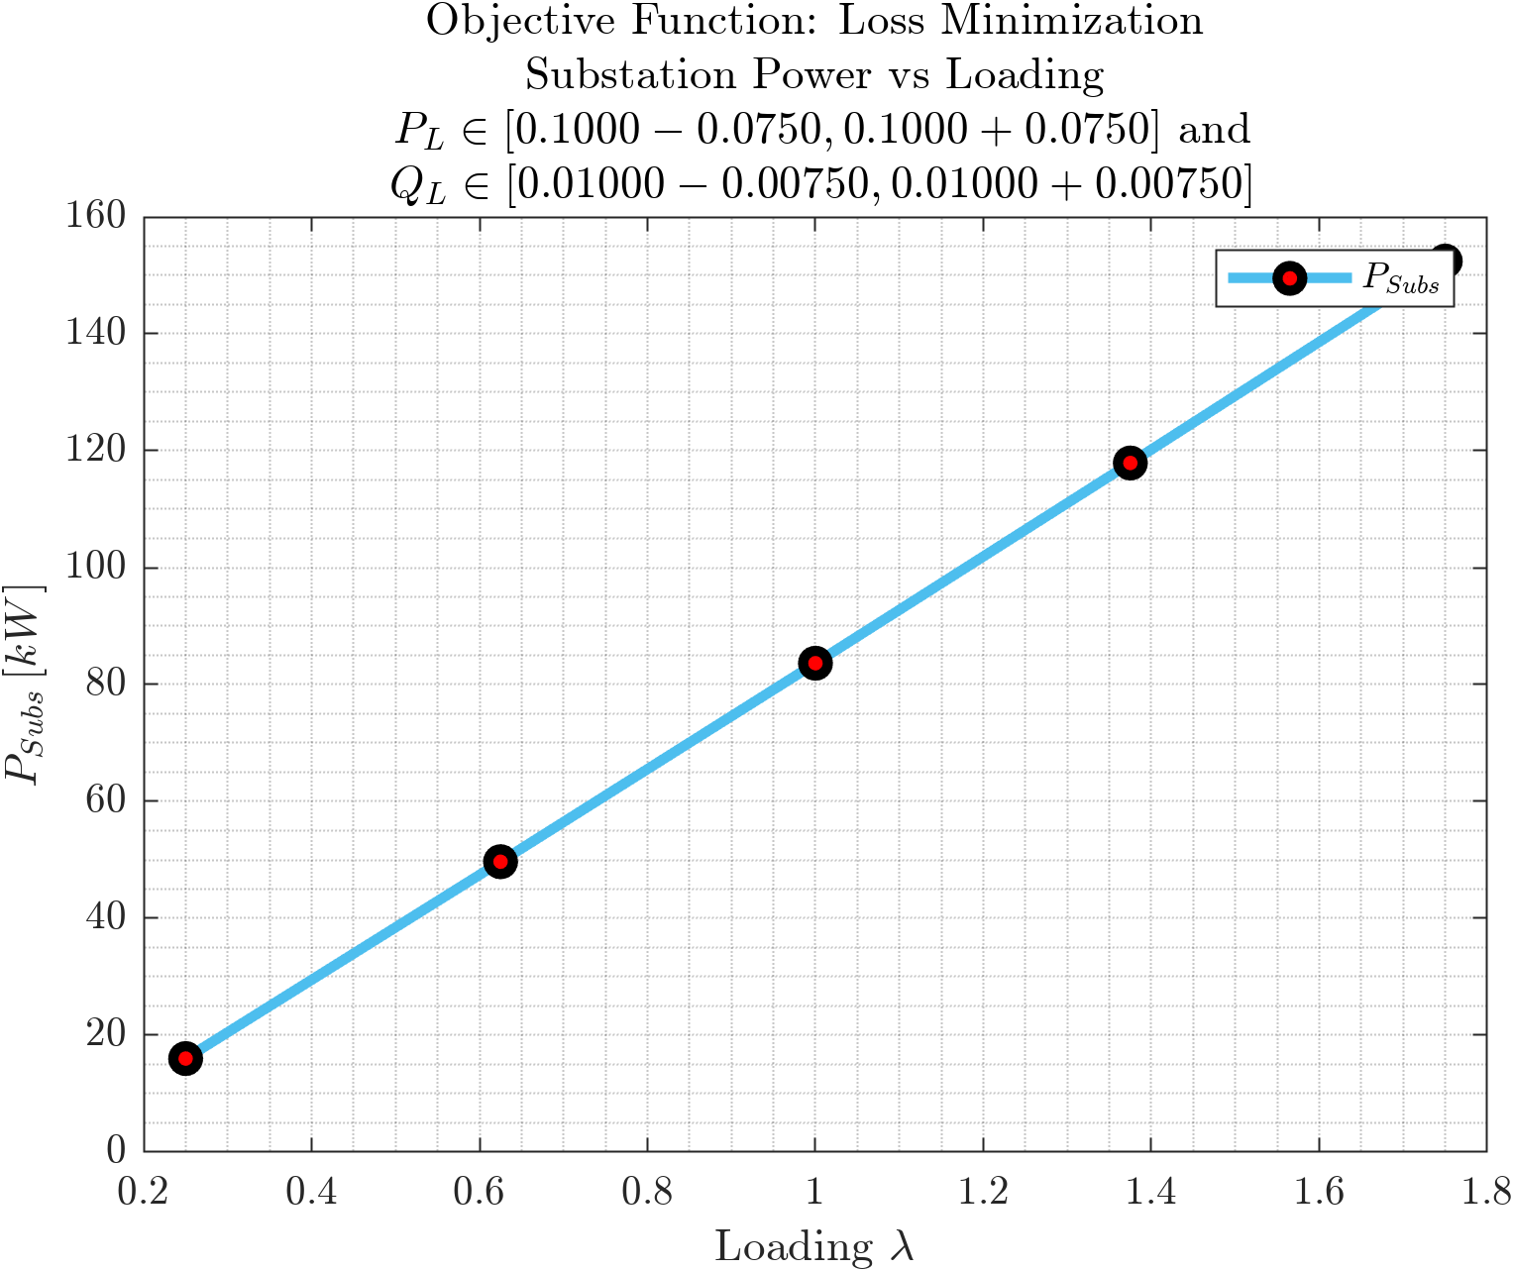
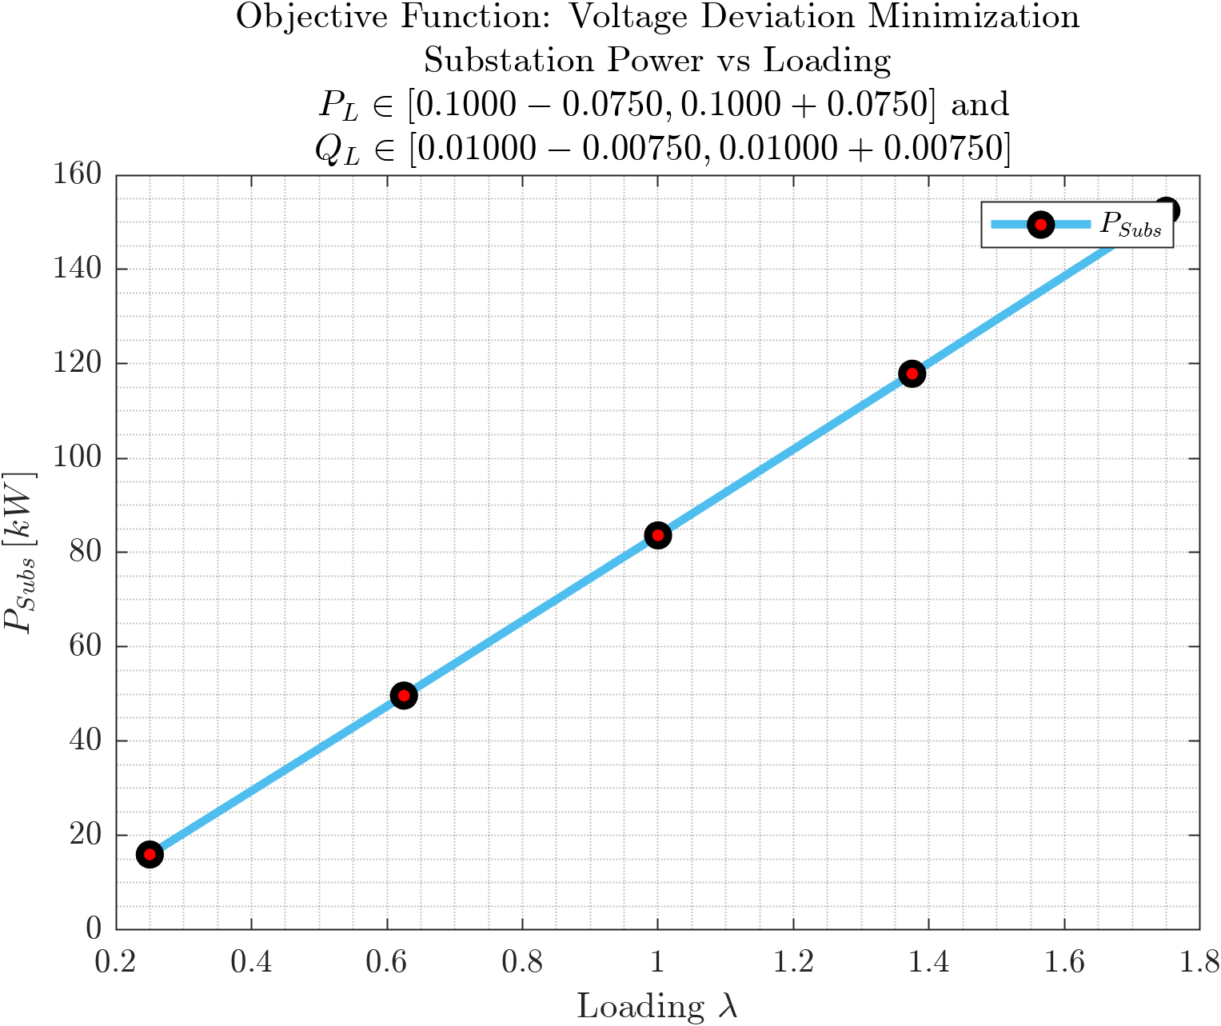
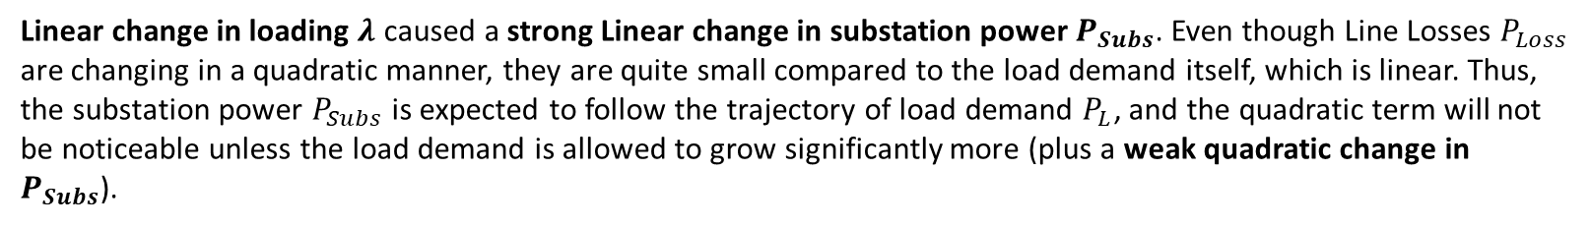
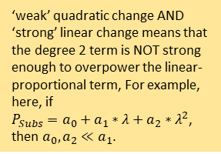
Substation Power vs Load Demand
Objective Functions: Loss Minimization, Voltage Deviation Minimization
Cover
Prob
‘weak’ quadratic change AND ‘strong’ linear change means that the degree 2 term is NOT strong enough to overpower the linear-proportional term, For example, here, if $P_{Subs}=a_{0}+a_{1}∗λ+a_{2}∗λ^{2}$, then $a_{0}, a_{2}≪a_{1}$.
$$P_{Loss}$$
$$P_{Subs}$$
$$Q_{DER}$$
$$P_{12}$$
$$Q_{12}$$
Linear change in loading $λ$ caused a strong Linear change in substation power $P_{Subs}$. Even though Line Losses $P_{Loss}$ are changing in a quadratic manner, they are quite small compared to the load demand itself, which is linear. Thus, the substation power $P_{Subs}$ is expected to follow the trajectory of load demand $P_{L}$, and the quadratic term will not be noticeable unless the load demand is allowed to grow significantly more (plus a weak quadratic change in $P_{Subs}$).
$$V_{1}$$
$$ΔV$$

Slide 14
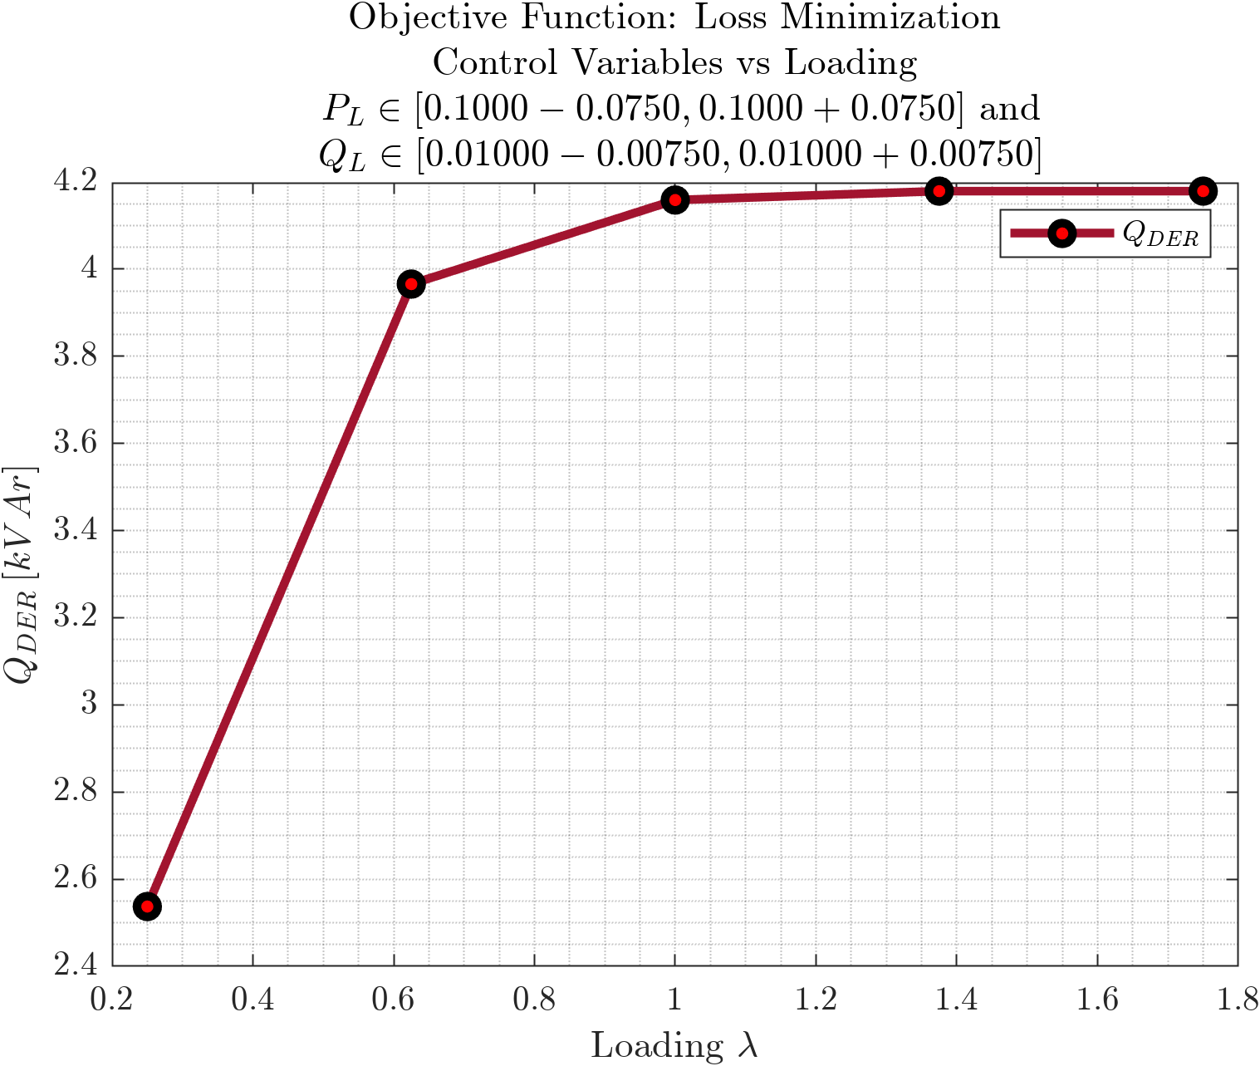
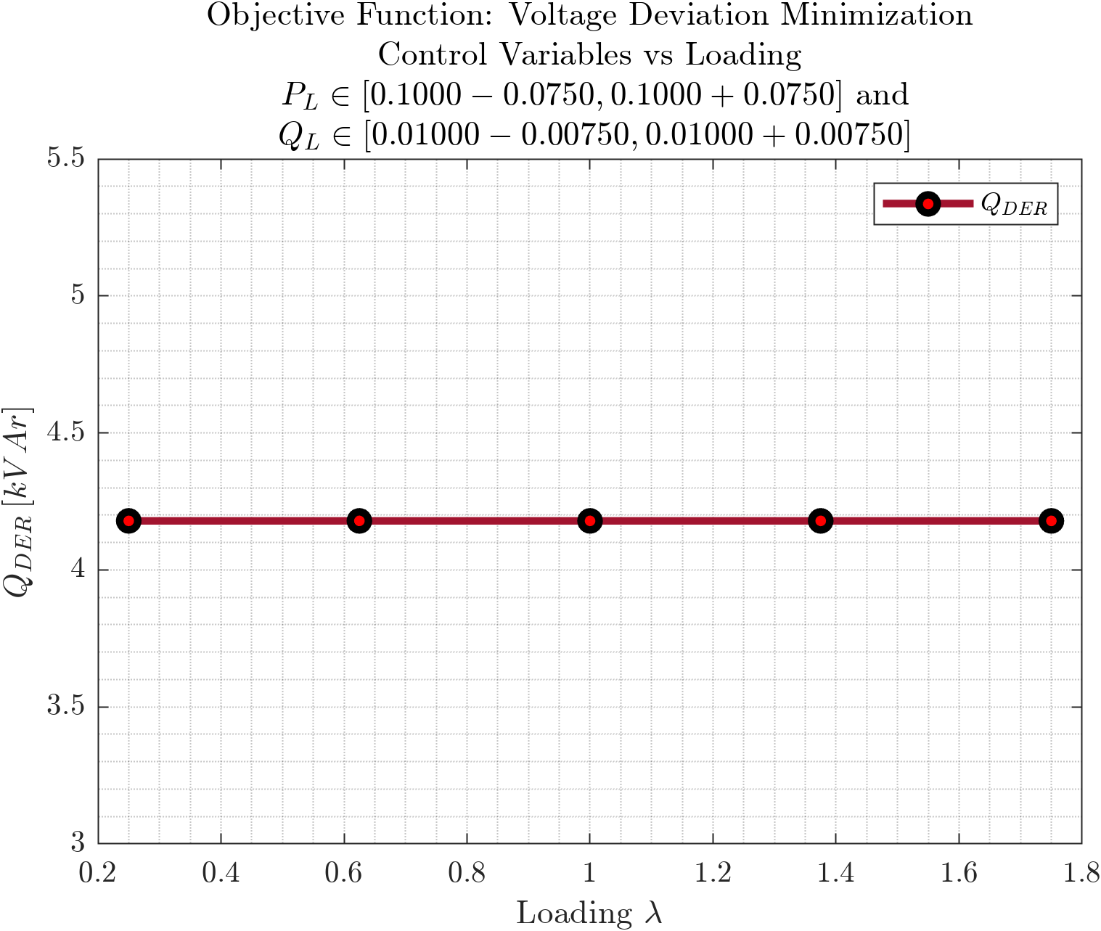
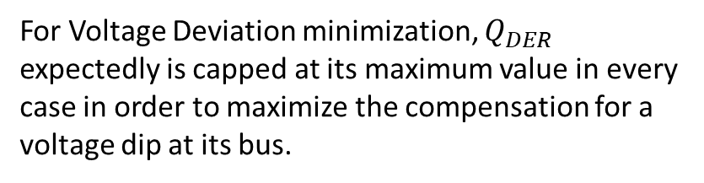
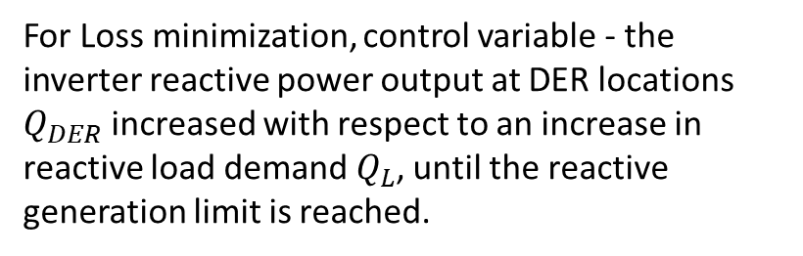
DER Reactive Power vs Load Demand
Objective Functions: Loss Minimization, Voltage Deviation Minimization
Cover
Prob
$$P_{Loss}$$
$$P_{Subs}$$
$$Q_{DER}$$
$$P_{12}$$
For Loss minimization, control variable - the inverter reactive power output at DER locations $Q_{DER}$ increased with respect to an increase in reactive load demand $Q_{L}$, until the reactive generation limit is reached.
For Voltage Deviation minimization, $Q_{DER}$ expectedly is capped at its maximum value in every case in order to maximize the compensation for a voltage dip at its bus.
$$Q_{12}$$
$$V_{1}$$
$$ΔV$$

Slide 15
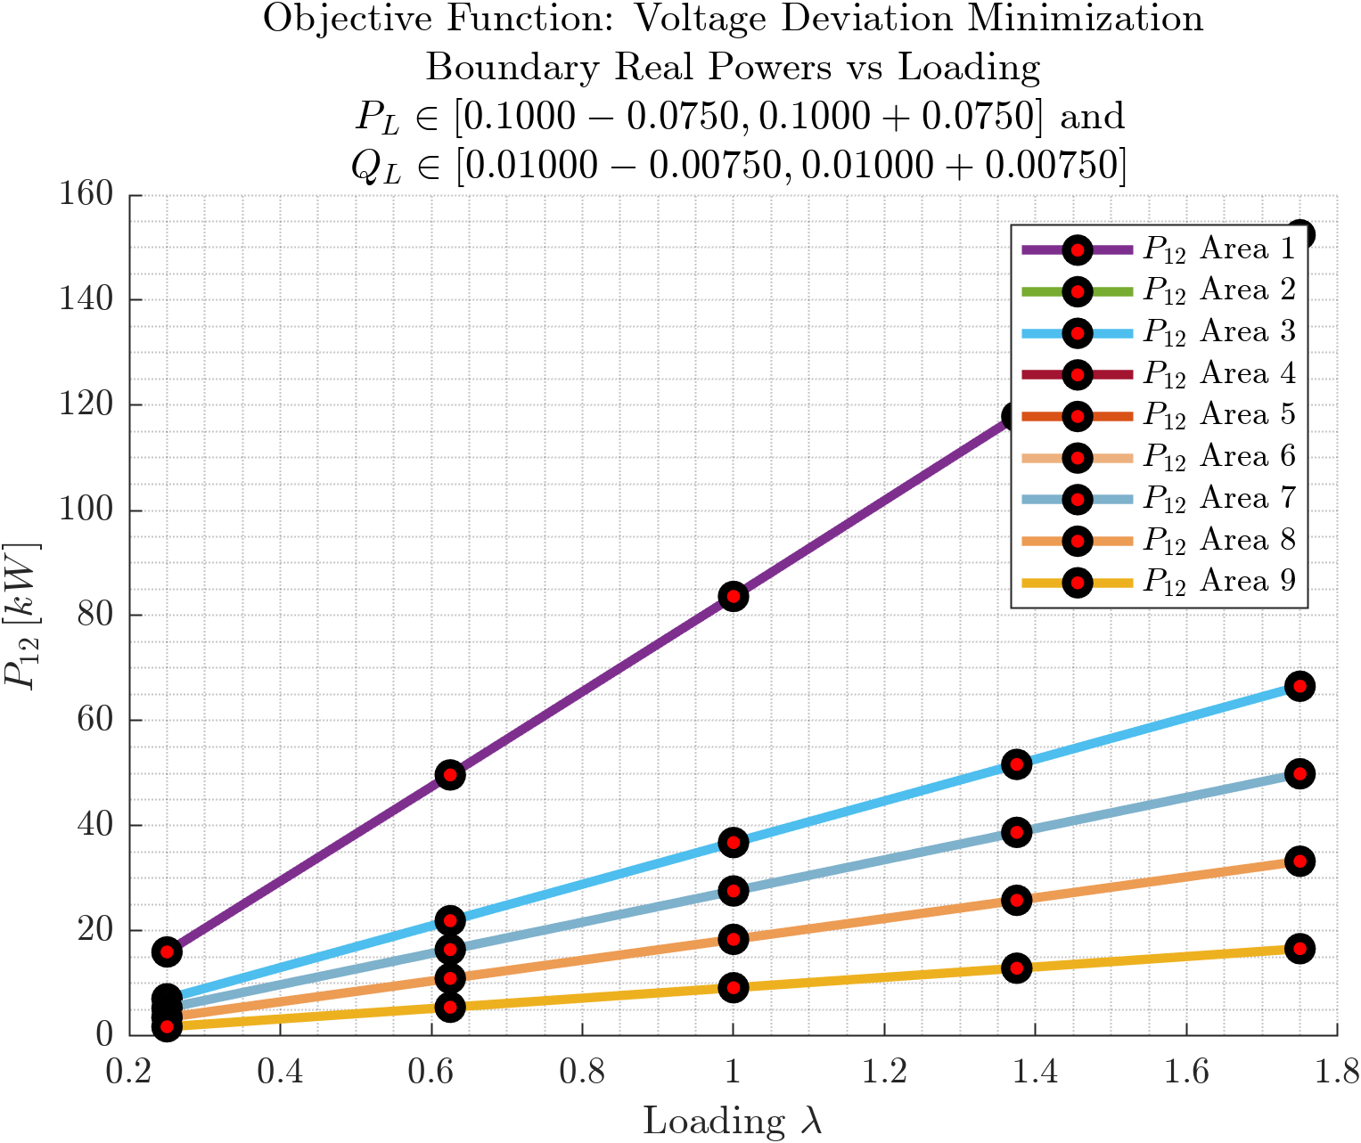
Real Power at Area Boundaries vs Load Demand
Objective Functions: Loss Minimization, Voltage Deviation Minimization
Cover
Prob
$$P_{Loss}$$
$$P_{Subs}$$
$$Q_{DER}$$
$$P_{12}$$
Strong linear relationship between loading $λ$ and real power exchanged at boundaries $P_{12}$.
$$Q_{12}$$
$$V_{1}$$
$$ΔV$$

Slide 16
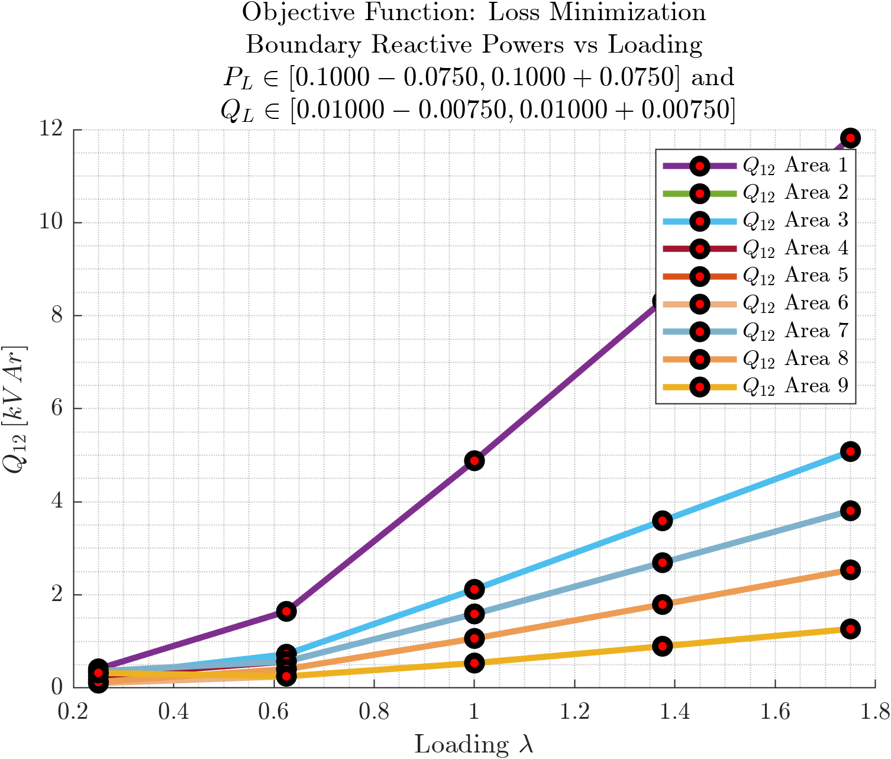
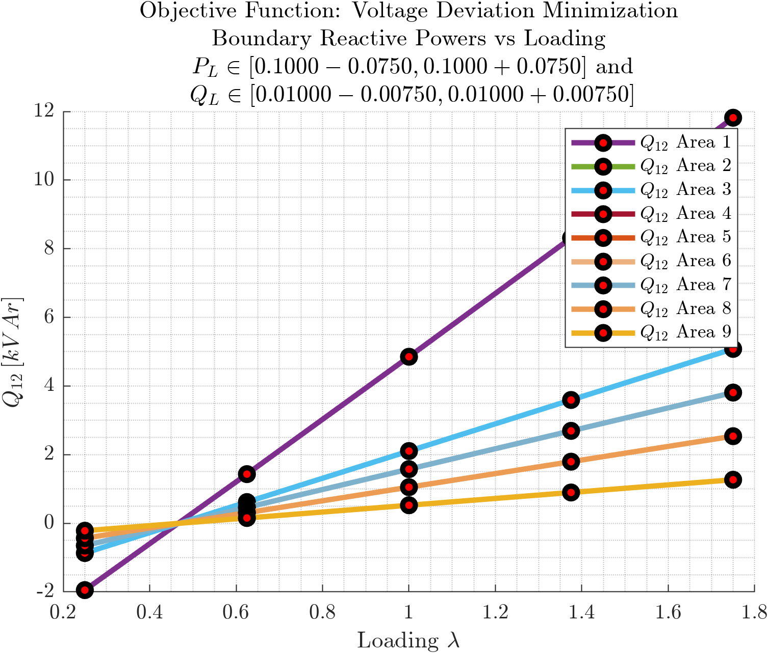
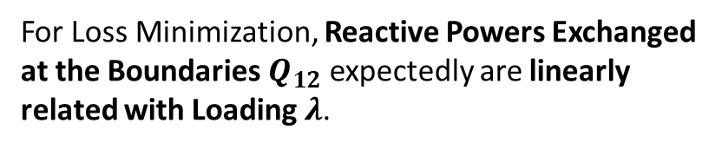
Reactive Power at Area Boundaries vs Load Demand
Objective Functions: Loss Minimization, Voltage Deviation Minimization
Cover
Prob
$$P_{Loss}$$
$$P_{Subs}$$
$$Q_{DER}$$
$$P_{12}$$
For Loss Minimization, Reactive Powers Exchanged at the Boundaries $Q_{12}$ expectedly are linearly related with Loading $λ$.
For Voltage Deviation minimization, also a linear relation, but for very low loading there is a backward flow of reactive power at boundaries. (Why?)
$$Q_{12}$$
$$V_{1}$$
$$ΔV$$

Slide 17
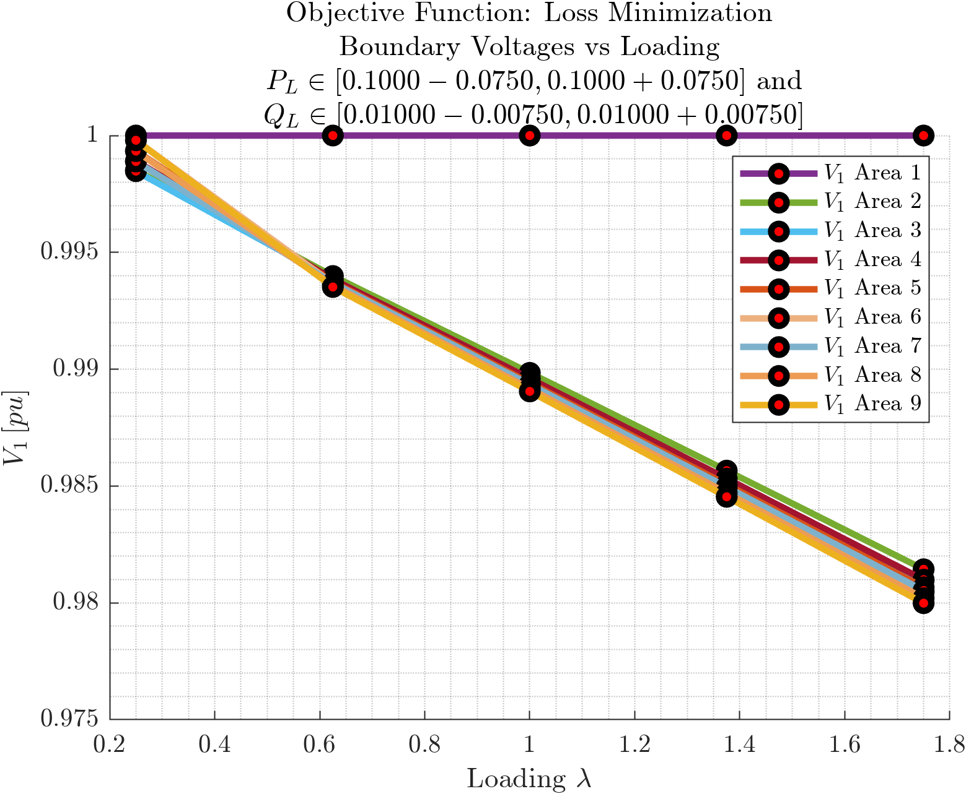
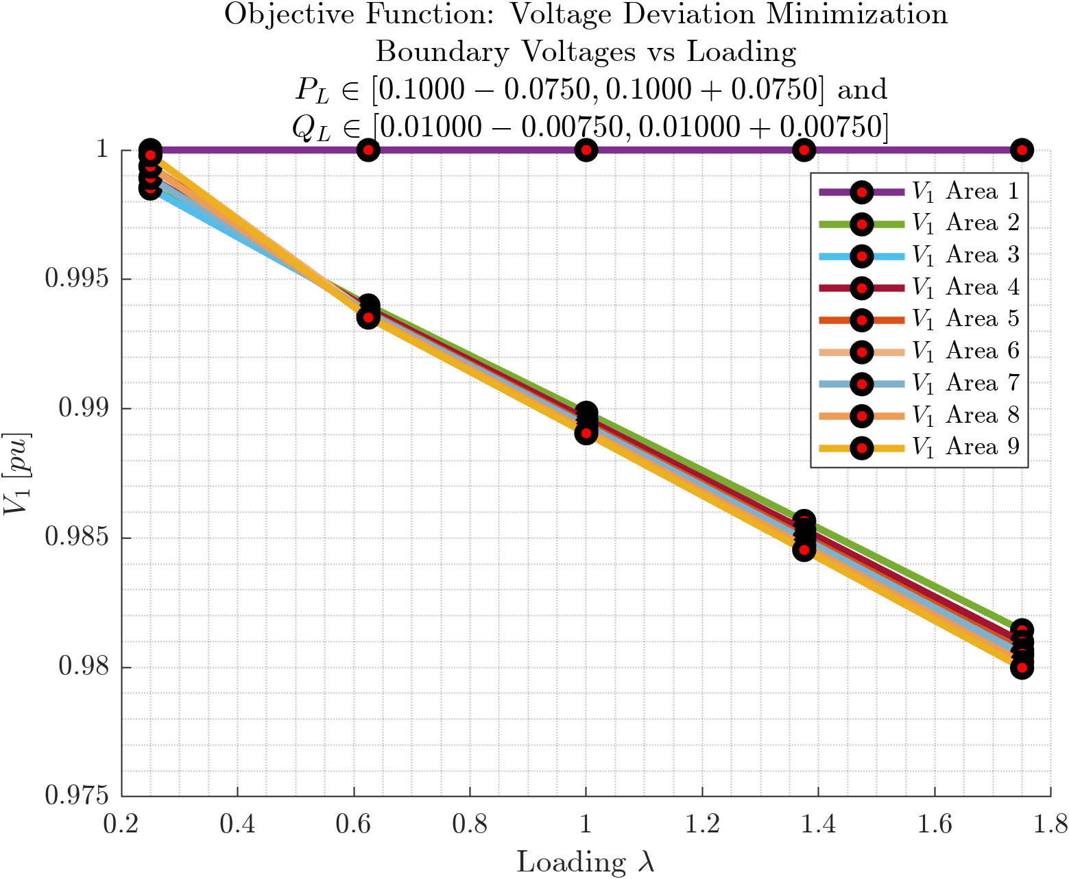
Voltages at Area Boundaries vs Load Demand
Objective Functions: Loss Minimization, Voltage Deviation Minimization
Cover
Prob
$$P_{Loss}$$
$$P_{Subs}$$
$$Q_{DER}$$
$$P_{12}$$
$$Q_{12}$$
Boundary Voltage $V_{1}$ is weakly linearly decreasing (voltage drop $ΔV$ is strongly linearly increasing) with loading $λ$. The trend, including the range of variation is same as that for varying impedances.
$$V_{1}$$
$$ΔV$$

Slide 18
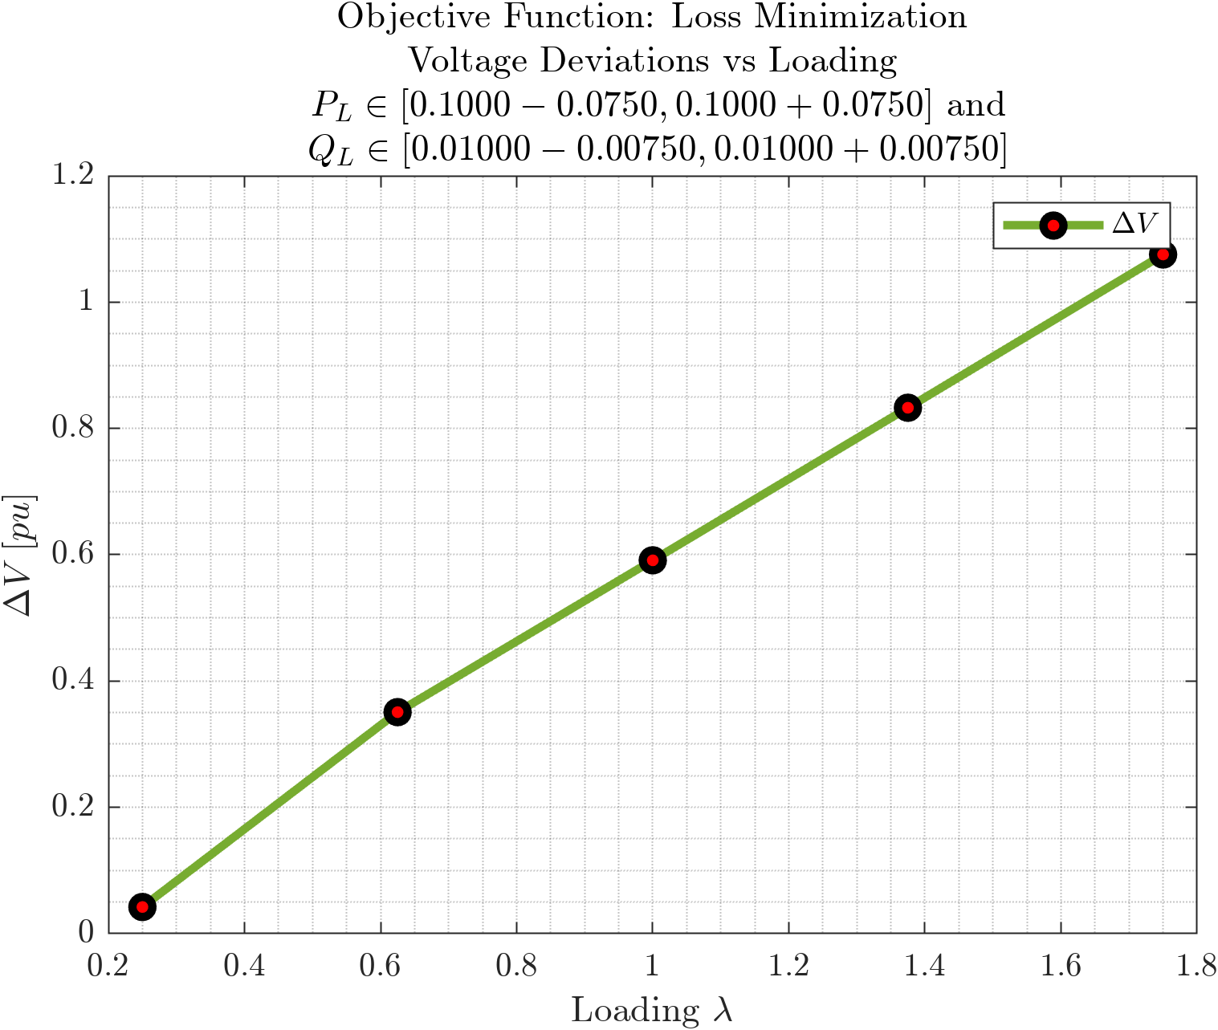
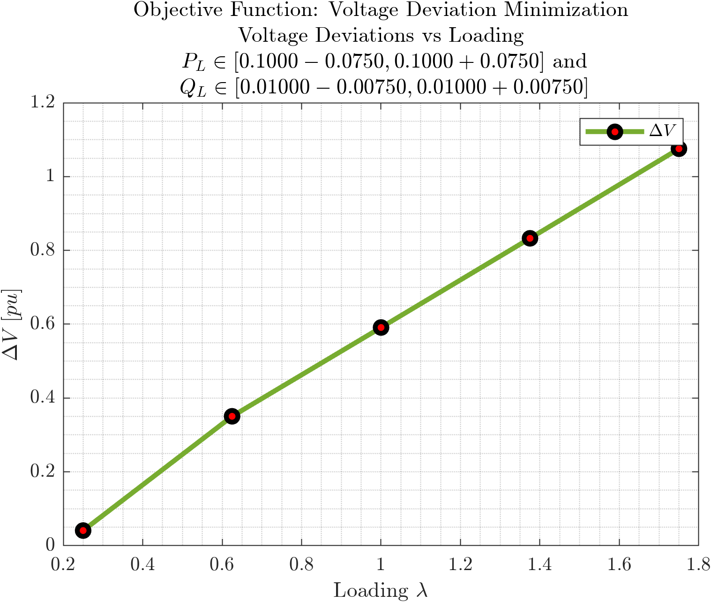
Voltage Deviation vs Load Demand
Objective Functions: Loss Minimization, Voltage Deviation Minimization
Cover
Prob
$$P_{Loss}$$
$$P_{Subs}$$
$$Q_{DER}$$
$$P_{12}$$
$$Q_{12}$$
Voltage Deviation $ΔV$ is strongly linearly varying with loading $λ$. The trend is almost the same as that for varying impedance.
$$V_{1}$$
$$ΔV$$

Slide 19
References
[1] Sadnan, R., & Dubey, A. (2022). Distributed Computing for Scalable Optimal Power Flow in Large Radial Electric Power Distribution Systems with Distributed Energy Resources. arXiv, 2211.03920. Retrieved from https://arxiv.org/abs/2211.03920v1

